Slide 1
The Respiratory System: Gas Exchange and Regulation of Breathing
17

Slide 2
Chapter Opener
17.1 Overview of Pulmonary Circulation
17.2 Diffusion of Gases
17.3 Exchange of Oxygen and Carbon Dioxide
17.4 Transport of Gases in the Blood
17.5 Central Regulation of Ventilation
17.6 Control of Ventilation by Chemoreceptors
17.7 Local Regulation of Ventilation and Perfusion
17.8 Respiratory System in Acid-Base Homeostasis

Slide 3
17.1 Overview of Pulmonary Circulation
Arterial blood O₂ and CO₂ levels remain relatively constant
O₂ moves from alveoli to blood at the same rate it is consumed by cells
CO₂ moves from blood to alveoli at the same rate it is produced by cells

Slide 4
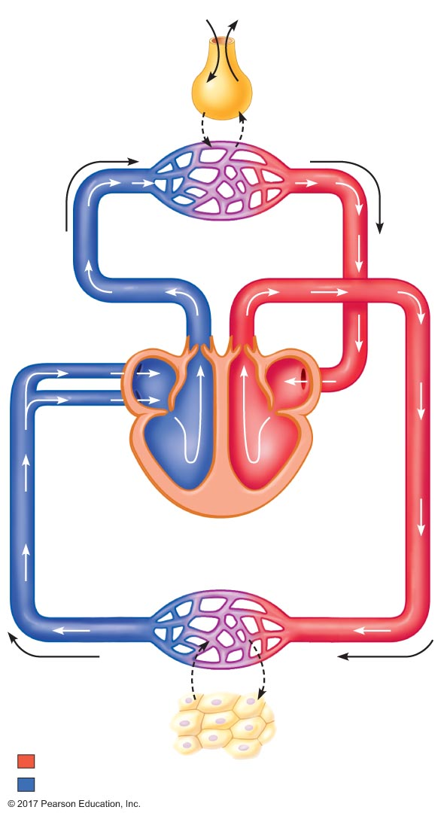
Figure 17.1 Movements of oxygen and carbon dioxide in pulmonary and systemic tissues during rest.
882 mL/min
O₂
200 mL/min CO₂
632 mL/min O₂
Alveolus
in lungs
250 mL/min
O₂
200 mL/min
CO₂
750 mL/min O₂
2700 mL/min CO₂
1000 mL/min O₂
2500 mL/min CO₂
Pulmonary capillaries
Pulmonary
arteries
Pulmonary
veins
Right
atrium
Left
atrium
Right
ventricle
Left
ventricle
Systemic veins
Systemic arteries
Systemic capillaries
750 mL/min O₂
2700 mL/min CO₂
1000 mL/min O₂
2500 mL/min CO₂
200
mL/min
CO₂
250
mL/min
O₂
Oxygenated blood
Cells in tissues
throughout body
Deoxygenated blood

Slide 5
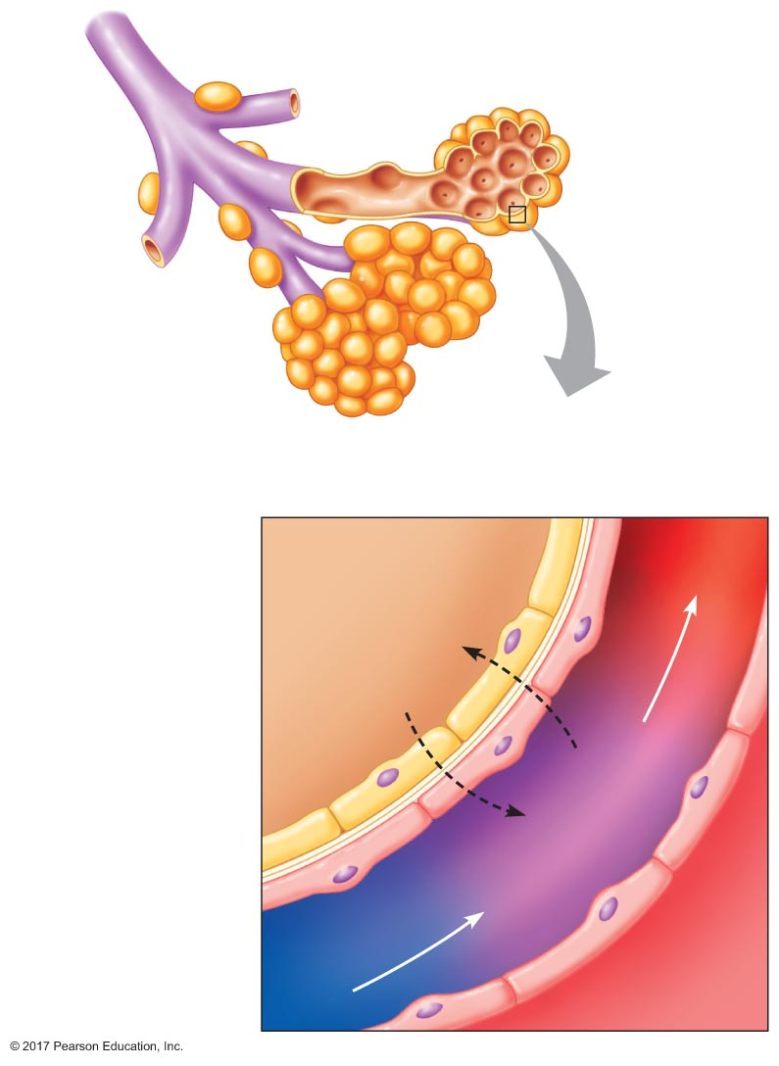
Figure 17.2 The respiratory membrane.
Alveoli
Respiratory
membrane
Alveolar
air space
Oxygenated
blood
CO₂
Type I alveolar cell
O₂
Alveolar
basement
membrane
Capillary
basement
membrane
Deoxygenated
blood
Endothelial
cell in
capillary wall
Capillary

Slide 6
17.2 Diffusion of Gases
Partial pressures of gases
Solubility of gases in liquids

Slide 7
Partial Pressure of Gases
Ideal gas law
Pressure of a gas depends on the temperature, number of gas molecules, and volume
PV = nRT
P = nRT/V

Slide 8
Partial Pressure of Gases
Gas mixtures
Many gases are mixtures of different molecules
Partial pressure of a gas = proportion of pressure of entire gas that is due to presence of the individual gas
P_{total} = P₁ + P₂ + P₃ + … P_{n}
Partial pressure of a gas depends on fractional concentration of the gas
Total pressure of gas mixture
P_{gas} = %_{gas} × P_{total}

Slide 9
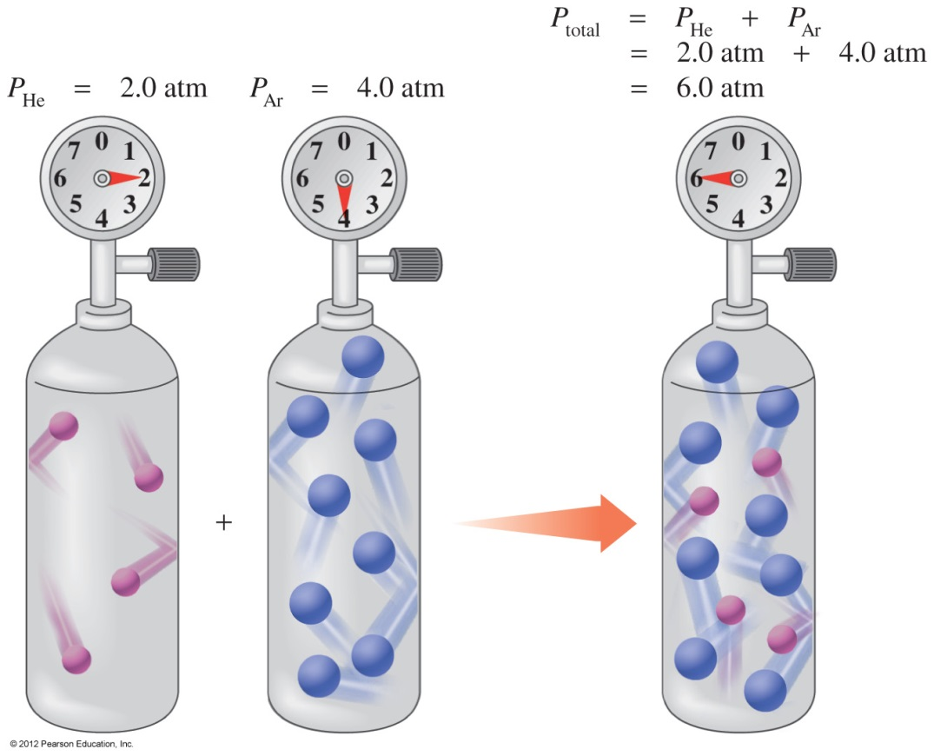
Partial Pressure
The partial pressure of a gas is the pressure that each gas in a mixture would exert if it were by itself in the container.

Slide 10
Dalton’s Law of Partial Pressures
Dalton’s law of partial pressures indicates that
pressure depends on the total number of gas particles, not on the types of particles
the total pressure exerted by gases in a mixture is the sum of the partial pressures of those gases
P_{T} = P₁ + P₂ + P₃ + ....

Slide 11
Partial Pressure of Gases
Gas mixtures
Many gases are mixtures of different molecules
Partial pressure of a gas = proportion of pressure of entire gas that is due to presence of the individual gas
P_{total} = P₁ + P₂ + P₃ + … P_{n}
Partial pressure of a gas depends on fractional concentration of the gas
Total pressure of gas mixture
P_{gas} = %_{gas} × P_{total}

Slide 12
Partial Pressure of Gases
Composition of air
79% nitrogen
21% oxygen
Trace amounts of carbon dioxide, helium, argon, and other gases
Water can be a factor depending on humidity
P_{air} = 760 mm Hg = P_{N2} + P_{O2}
P_{N2} = 0.79 × 760 mm Hg = 600 mm Hg
P_{O2} = 0.21 × 760 mm Hg = 160 mm Hg
Air is only 0.03% carbon dioxide
P_{CO2} = 0.0003 × 760 mm Hg = 0.23 mm Hg

Slide 13
Partial Pressure of Gases
Composition of air at 100% humidity
P_{air} = 760 mm Hg = P_{N2} + P_{O2} + P_{H2O}
P_{N2} = 0.741 × 760 mm Hg = 563 mm Hg
P_{O2} = 0.196 × 760 mm Hg = 149 mm Hg
P_{H2O} = 0.062 × 760 mm Hg = 47 mm Hg
P_{CO2} = 0.00027 × 760 mm Hg = 0.21 mm Hg

Slide 14
Solubility of Gases in Liquids
Gas molecules can exist in gas form or dissolved in a liquid
Ability to dissolve depends on properties of the gas and properties of the liquid
Both vaporized and dissolved gases exert partial pressures
The partial pressure of a gas affects the amount of gas that goes into solution
Partial pressures of vaporized and dissolved gases will be equal at equilibrium

Slide 15
Solubility of Gases in Liquids
Henry's law
c = kP
c = molar concentration of dissolved gas
k = Henry's law constant
P = partial pressure of gas in atmospheres

Slide 16
Solubility of Gases in Liquids
Oxygen and carbon dioxide solubility
At 100 mm Hg partial pressure in water
[O₂] in water = 0.15 mmole/L
[CO₂] in water = 3.0 mmole/L
CO₂ is more soluble than O₂ in water (and blood).

Slide 17
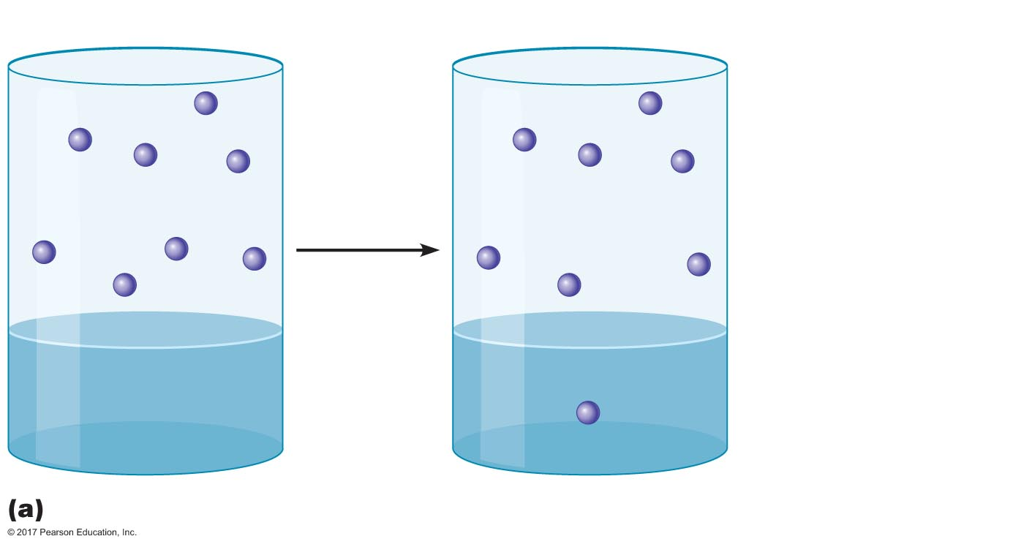
Figure 17.3a Solubilities of oxygen and carbon dioxide in water.
O₂ molecule
Air
Air
[O₂]_{Air} = 5.2 mmole/L
P_{O2} = 100 mm Hg
P_{O2} = 100 mm Hg
Equilibration
[O₂]_{Water} = 0.15 mmole/L
P_{O2} = 0
P_{O2} = 100 mm Hg
Water
Water

Slide 18
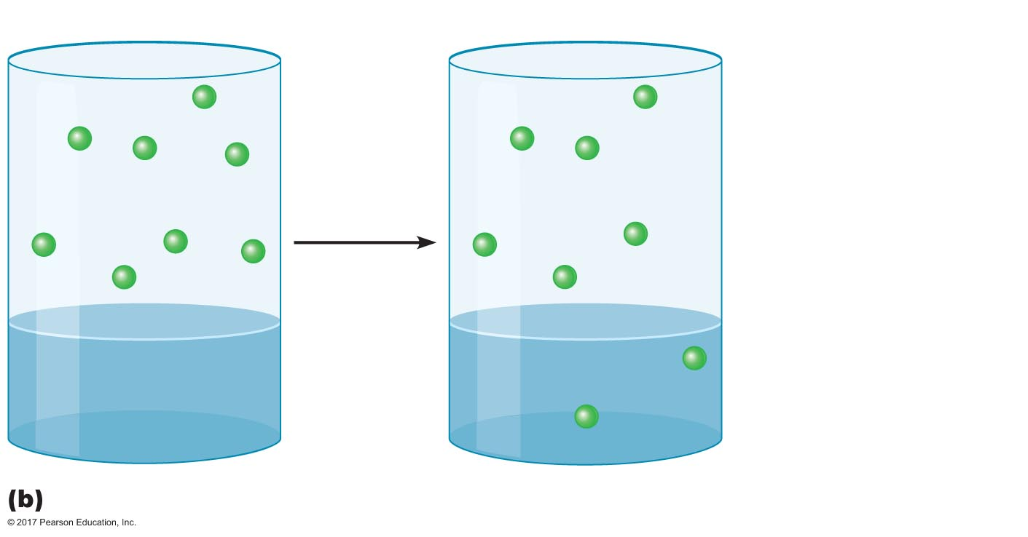
Figure 17.3b Solubilities of oxygen and carbon dioxide in water.
CO₂ molecule
Air
Air
[CO₂]_{Air} = 5.2 mmole/L
P_{CO2} = 100 mm Hg
Equilibration
P_{CO2} = 100 mm Hg
[CO₂]_{Water} = 3.0 mmole/L
P_{CO2} = 0
P_{CO2} = 100 mm Hg
Water
Water

Slide 19
17.3 Exchange of Oxygen and Carbon Dioxide
Gas exchange in the lungs
Gas exchange in respiring tissue
Determinants of alveolar P_{O2} and P_{CO2}

Slide 20
Gas Exchange in the Lungs
Diffusion of gases
Gases diffuse down pressure gradients
High pressure → low pressure
In gas mixtures, gases diffuse down partial pressure gradients
High partial pressure → low partial pressure
A particular gas diffuses down its own partial pressure gradient
Presence of other gases is irrelevant

Slide 21
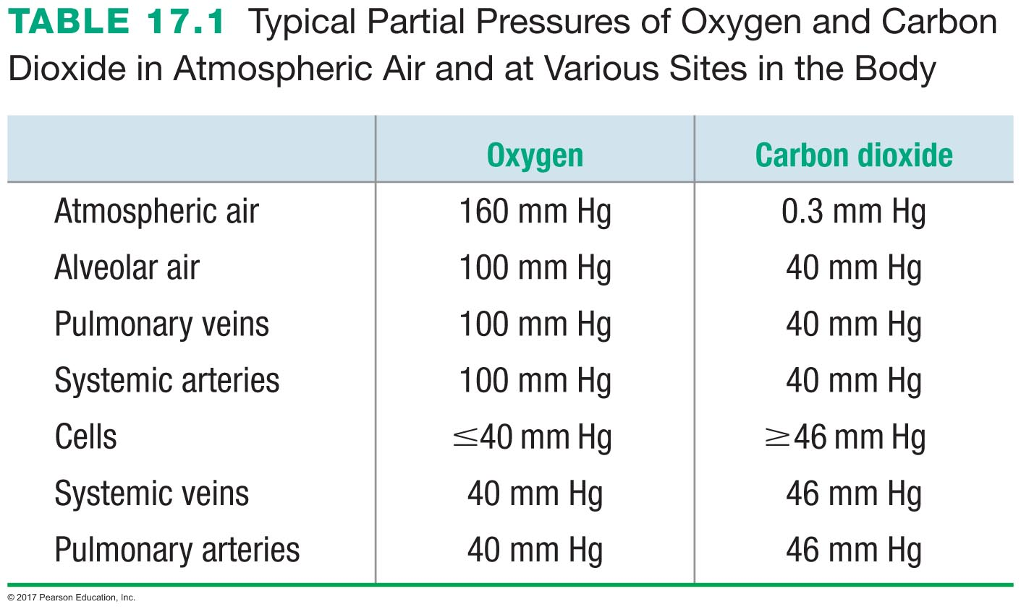

Slide 22
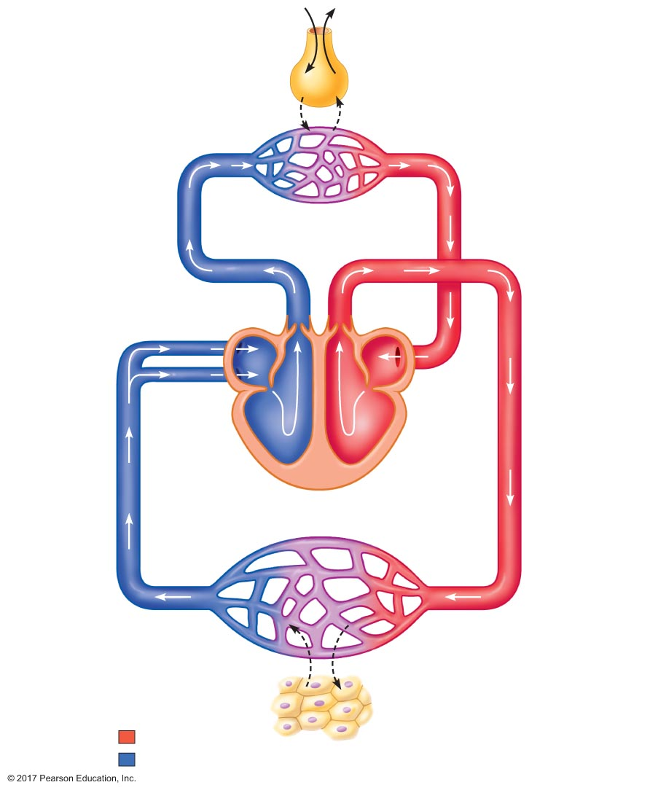
Figure 17.4 Partial pressures of oxygen and carbon dioxide in atmospheric air, in alveolar air, and at various sites in the body.
Slide 1
Atmosphere air (mm Hg)
Alveolar air (mm Hg)
P_{O2} = 160
P_{O2} = 100
P_{CO2} = 0.3
O₂
CO₂
P_{CO2} = 40
O₂
CO₂
Pulmonary
arteries (mm Hg)
Pulmonary
veins (mm Hg)
P_{O2} = 40
Pulmonary capillaries
P_{O2} = 100
P_{CO2} = 46
Pulmonary
arteries
Pulmonary
veins
P_{CO2} = 40
Systemic
veins (mm Hg)
Systemic
arteries (mm Hg)
P_{O2} = 40
Systemic veins
Systemic arteries
P_{O2} = 100
P_{CO2} = 46
Systemic capillaries
P_{CO2} = 40
CO₂
O₂
Cells (mm Hg)
P_{O2} = 40
P_{CO2} = 46
Oxygenated blood
Cells in tissues
throughout body
Deoxygenated blood

Slide 23
Figure 17.4 Partial pressures of oxygen and carbon dioxide in atmospheric air, in alveolar air, and at various sites in the body.
Slide 2
Atmosphere air (mm Hg)
P_{O2} = 160
P_{CO2} = 0.3
O₂
CO₂
O₂
CO₂
Pulmonary capillaries
Pulmonary
arteries
Pulmonary
veins
Systemic veins
Systemic arteries
Systemic capillaries
CO₂
O₂
Oxygenated blood
Cells in tissues
throughout body
Deoxygenated blood

Slide 24
Figure 17.4 Partial pressures of oxygen and carbon dioxide in atmospheric air, in alveolar air, and at various sites in the body.
Slide 3
Atmosphere air (mm Hg)
Alveolar air (mm Hg)
P_{O2} = 160
P_{O2} = 100
P_{CO2} = 0.3
O₂
CO₂
P_{CO2} = 40
O₂
CO₂
Pulmonary capillaries
Pulmonary
arteries
Pulmonary
veins
Systemic veins
Systemic arteries
Systemic capillaries
CO₂
O₂
Oxygenated blood
Cells in tissues
throughout body
Deoxygenated blood

Slide 25
Figure 17.4 Partial pressures of oxygen and carbon dioxide in atmospheric air, in alveolar air, and at various sites in the body.
Slide 4
Atmosphere air (mm Hg)
Alveolar air (mm Hg)
P_{O2} = 160
P_{O2} = 100
P_{CO2} = 0.3
O₂
CO₂
P_{CO2} = 40
O₂
CO₂
Pulmonary
veins (mm Hg)
Pulmonary capillaries
P_{O2} = 100
Pulmonary
arteries
Pulmonary
veins
P_{CO2} = 40
Systemic
arteries (mm Hg)
Systemic veins
Systemic arteries
P_{O2} = 100
Systemic capillaries
P_{CO2} = 40
CO₂
O₂
Oxygenated blood
Cells in tissues
throughout body
Deoxygenated blood

Slide 26
Figure 17.4 Partial pressures of oxygen and carbon dioxide in atmospheric air, in alveolar air, and at various sites in the body.
Slide 5
Atmosphere air (mm Hg)
Alveolar air (mm Hg)
P_{O2} = 160
P_{O2} = 100
P_{CO2} = 0.3
O₂
CO₂
P_{CO2} = 40
O₂
CO₂
Pulmonary
veins (mm Hg)
Pulmonary capillaries
P_{O2} = 100
Pulmonary
arteries
Pulmonary
veins
P_{CO2} = 40
Systemic
arteries (mm Hg)
Systemic veins
Systemic arteries
P_{O2} = 100
Systemic capillaries
P_{CO2} = 40
CO₂
O₂
Cells (mm Hg)
P_{O2} = 40
P_{CO2} = 46
Oxygenated blood
Cells in tissues
throughout body
Deoxygenated blood

Slide 27
Figure 17.4 Partial pressures of oxygen and carbon dioxide in atmospheric air, in alveolar air, and at various sites in the body.
Slide 6
Atmosphere air (mm Hg)
Alveolar air (mm Hg)
P_{O2} = 160
P_{O2} = 100
P_{CO2} = 0.3
O₂
CO₂
P_{CO2} = 40
O₂
CO₂
Pulmonary
arteries (mm Hg)
Pulmonary
veins (mm Hg)
P_{O2} = 40
Pulmonary capillaries
P_{O2} = 100
P_{CO2} = 46
Pulmonary
arteries
Pulmonary
veins
P_{CO2} = 40
Systemic
veins (mm Hg)
Systemic
arteries (mm Hg)
P_{O2} = 40
Systemic veins
Systemic arteries
P_{O2} = 100
P_{CO2} = 46
Systemic capillaries
P_{CO2} = 40
CO₂
O₂
Cells (mm Hg)
P_{O2} = 40
P_{CO2} = 46
Oxygenated blood
Cells in tissues
throughout body
Deoxygenated blood

Slide 28
Gas Exchange in the Lungs
Diffusion between alveoli and blood is rapid
Small diffusion barrier
Large surface area

Slide 29
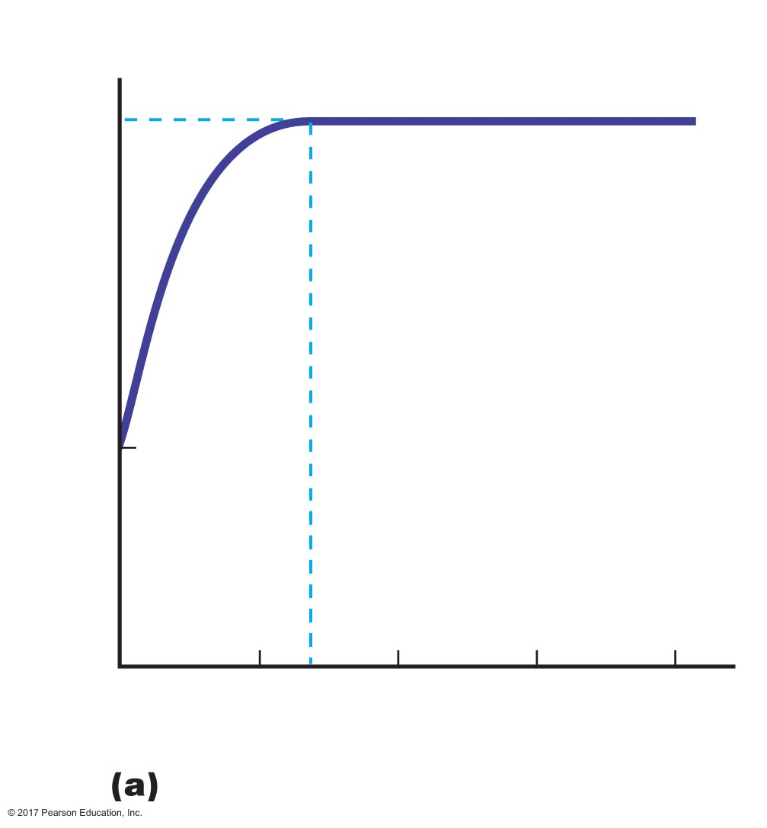
Figure 17.5a Gas exchange as a function of pulmonary capillary length.
Alveolar P_{O2}
100
P_{O2}
Partial pressure O₂ (mm Hg)
40
Mixed venous P_{O2}
0
33
50
75
100
Length of capillary (percent of total)

Slide 30
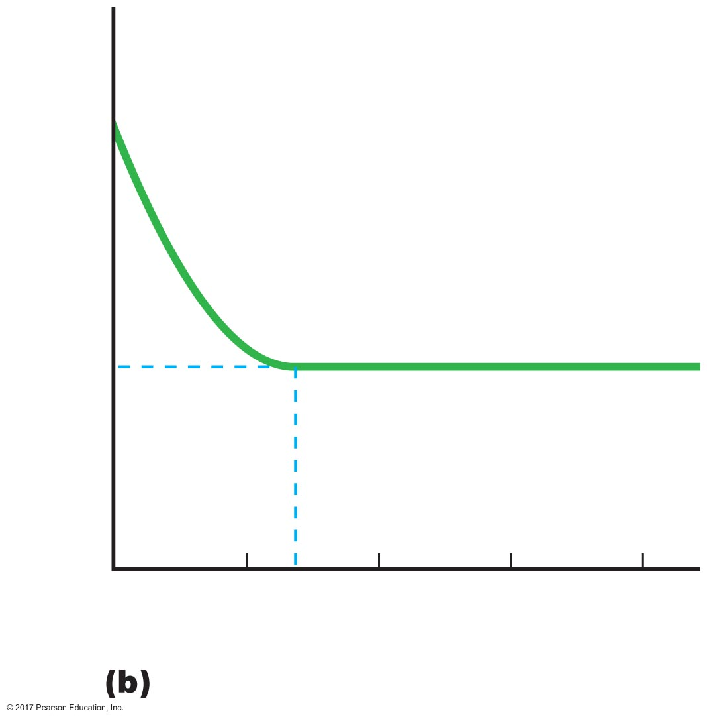
Figure 17.5b Gas exchange as a function of pulmonary capillary length.
Mixed venous P_{CO2}
46
Partial pressure CO₂ (mm Hg)
40
Alveolar P_{CO2}
35
0
33
50
75
100
Length of capillary (percent of total)

Slide 31
Gas Exchange in Respiring Tissue
Gases diffuse down partial pressure gradients
P_{O2} cells ≤ 40 mm Hg; P_{O2} systemic arteries = 100 mm Hg
Oxygen diffuses from blood to cells
P_{O2} systemic veins = 40 mm Hg
P_{CO2} cells ≥ 46 mm Hg; P_{CO2} systemic arteries = 40 mm Hg
Carbon dioxide diffuses from cells to blood
P_{CO2} systemic veins = 46 mm Hg

Slide 32
Gas Exchange in Respiring Tissue
Mixed venous blood
Amount of O₂ and CO₂ that is exchanged in a vascular bed depends on metabolic activity of the tissue
Greater rate of metabolism → greater exchange
P_{O2} and P_{CO2} in different systemic veins vary
All systemic venous blood returns to the right atrium and is pumped out of the right ventricle and into the pulmonary artery
Blood in pulmonary artery = mixed venous blood
P_{O2} = 40 mm Hg
P_{CO2} = 46 mm Hg

Slide 33
Determinants of Alveolar P_{O2} and P_{CO2}
Factors affecting alveolar partial pressures
P_{O2} and P_{CO2} of inspired air
Minute alveolar ventilation
Rates at which respiring tissues use O₂ and produce CO₂
Most critical is the rate of alveolar ventilation relative to the rate of O₂ use and CO₂ production

Slide 34
Determinants of Alveolar P_{O2} and P_{CO2}
Hyperpnea: increased ventilation due to increased demand
Minimal changes in arterial P_{O2} and P_{CO2}
Hypoventilation: ventilation does not meet demands
Arterial P_{O2} decreases
Arterial P_{CO2} increases
Hyperventilation: ventilation exceeds demands
Arterial P_{O2} increases
Arterial P_{CO2} decreases

Slide 35
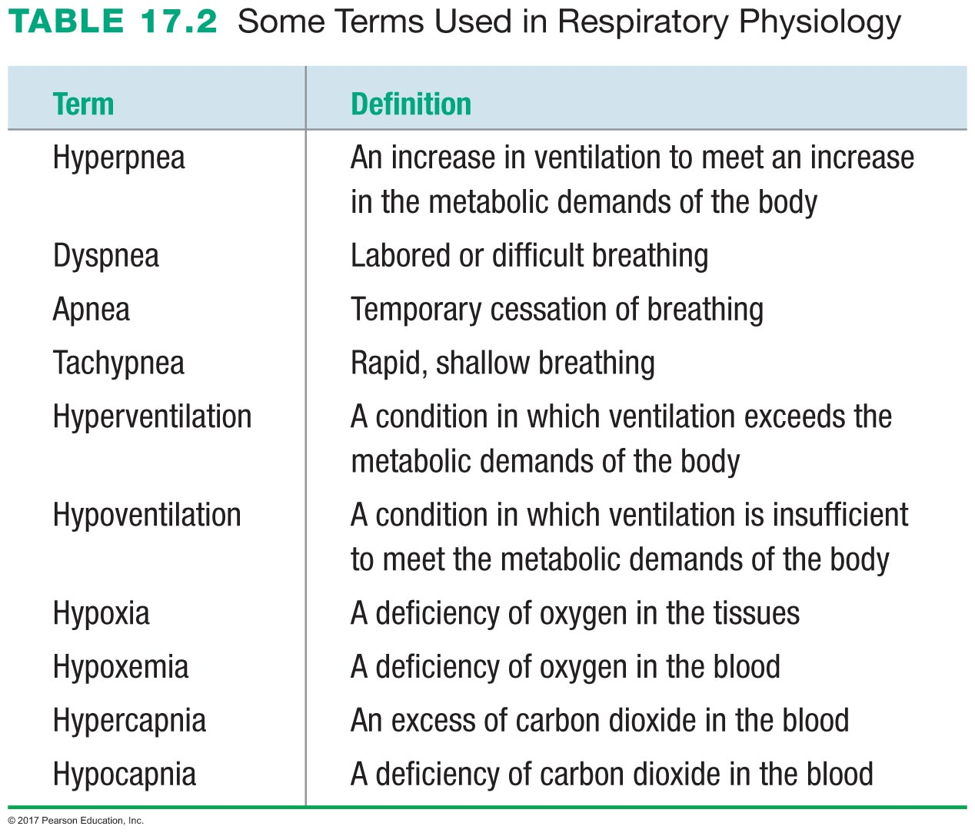

Slide 36
17.4 Transport of Gases in the Blood
Oxygen transport in blood
Carbon dioxide transport in blood

Slide 37
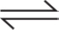
Oxygen Transport in the Blood
Oxygen transport by hemoglobin
O₂ is not very soluble in plasma
Only 3.0 mL of every 200 mL of arterial blood O₂ is dissolved in plasma (1.5%)
The other 197 mL of arterial blood O₂ is transported by hemoglobin
Oxygen binding to hemoglobin
Hb + O₂ Hb•O₂
Hb = deoxyhemoglobin
Hb•O₂ = oxyhemoglobin

Slide 38
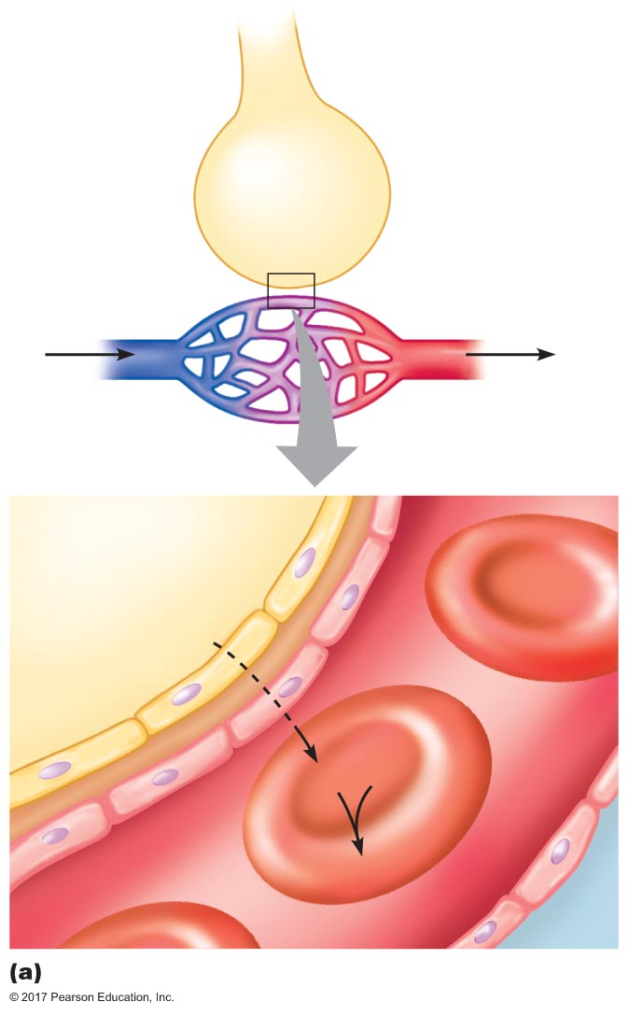
Figure 17.6a Transport of oxygen by hemoglobin.
Slide 1
Alveolus
in lungs
P_{O2} = 100 mm Hg
P_{O2} = 40 mm Hg
P_{O2} = 100 mm Hg
Pulmonary
capillaries
Alveolar air
Plasma
O₂
Alveolar
wall
Erythrocytes
O₂
Hb
Hb • O₂
Capillary
wall
Plasma

Slide 39
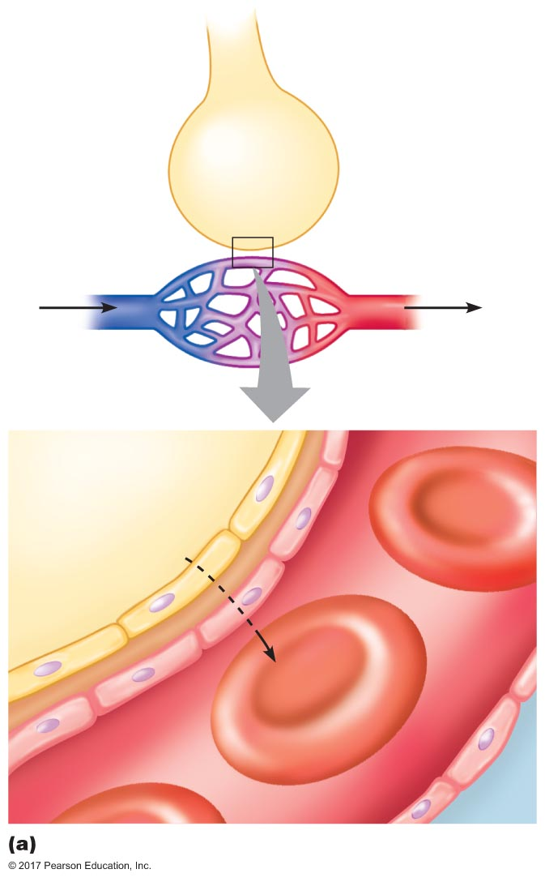
Figure 17.6a Transport of oxygen by hemoglobin.
Slide 2
Alveolus
in lungs
P_{O2} = 100 mm Hg
P_{O2} = 40 mm Hg
P_{O2} = 100 mm Hg
Pulmonary
capillaries
Alveolar air
Plasma
O₂
Alveolar
wall
Erythrocytes
Capillary
wall
Plasma

Slide 40
Figure 17.6a Transport of oxygen by hemoglobin.
Slide 3
Alveolus
in lungs
P_{O2} = 100 mm Hg
P_{O2} = 40 mm Hg
P_{O2} = 100 mm Hg
Pulmonary
capillaries
Alveolar air
Plasma
O₂
Alveolar
wall
Erythrocytes
O₂
Hb
Capillary
wall
Plasma

Slide 41
Figure 17.6a Transport of oxygen by hemoglobin.
Slide 4
Alveolus
in lungs
P_{O2} = 100 mm Hg
P_{O2} = 40 mm Hg
P_{O2} = 100 mm Hg
Pulmonary
capillaries
Alveolar air
Plasma
O₂
Alveolar
wall
Erythrocytes
O₂
Hb
Hb • O₂
Capillary
wall
Plasma

Slide 42
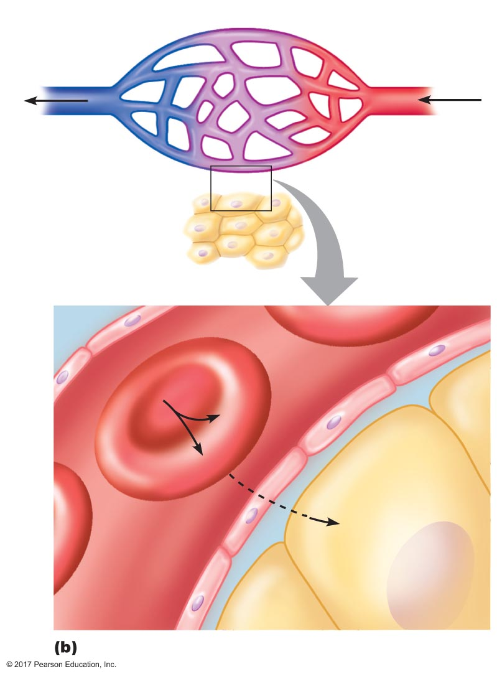
Figure 17.6b Transport of oxygen by hemoglobin.
Slide 1
Systemic capillaries
P_{O2} = 40 mm Hg
P_{O2} = 100 mm Hg
P_{O2} 40 mm Hg
Plasma
Erythrocytes
Hb • O₂
Hb
O₂
Tissue cell
O₂
Capillary
wall
Interstitial ﬂuid

Slide 43

Figure 17.6b Transport of oxygen by hemoglobin.
Slide 2
Systemic capillaries
P_{O2} = 40 mm Hg
P_{O2} = 100 mm Hg
P_{O2} 40 mm Hg
Plasma
Erythrocytes
Hb • O₂
Tissue cell
Capillary
wall
Interstitial ﬂuid

Slide 44

Figure 17.6b Transport of oxygen by hemoglobin.
Slide 3
Systemic capillaries
P_{O2} = 40 mm Hg
P_{O2} = 100 mm Hg
P_{O2} 40 mm Hg
Plasma
Erythrocytes
Hb • O₂
Hb
O₂
Tissue cell
Capillary
wall
Interstitial ﬂuid

Slide 45
Figure 17.6b Transport of oxygen by hemoglobin.
Slide 4
Systemic capillaries
P_{O2} = 40 mm Hg
P_{O2} = 100 mm Hg
P_{O2} 40 mm Hg
Plasma
Erythrocytes
Hb • O₂
Hb
O₂
Tissue cell
O₂
Capillary
wall
Interstitial ﬂuid

Slide 46
Oxygen Transport in the Blood
Saturation of hemoglobin
Hemoglobin can bind up to four oxygen molecules
Binding of oxygen to hemoglobin follows the law of mass action
More oxygen → more binds to hemoglobin
Nonlinear relationship: positive cooperativity
Saturation of hemoglobin is a measure of how much oxygen is bound to hemoglobin
100% saturation → all four binding sites on hemoglobin have oxygen bound to them

Slide 47
Oxygen Transport in the Blood
O₂-carrying capacity of blood
When 100% saturated, 1 g hemoglobin carries 1.34 mL O₂
Normal blood hemoglobin levels
2–17 g/dL
O₂-carrying capacity of hemoglobin in blood
200 mL O₂ per 1 L blood
Arterial blood
Hemoglobin is 98.5% saturated
Venous blood
Hemoglobin is 75% saturated

Slide 48
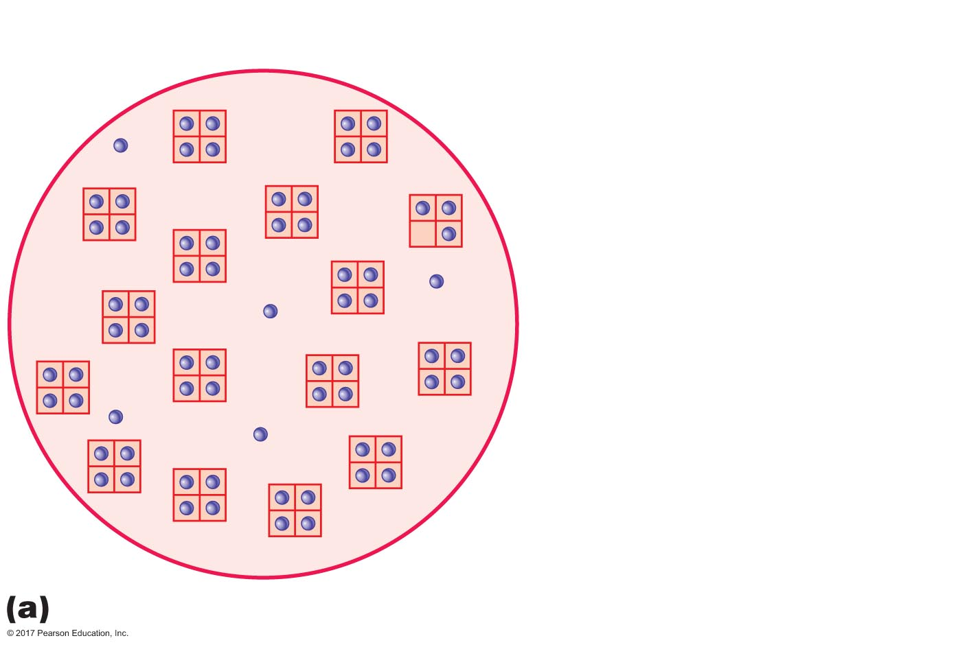
Figure 17.7a Saturation of hemoglobin.
Oxygen
Hemoglobin
Erythrocyte
Arterial blood
P_{O2} = 100 mm Hg
Hemoglobin = 98.5% saturated

Slide 49
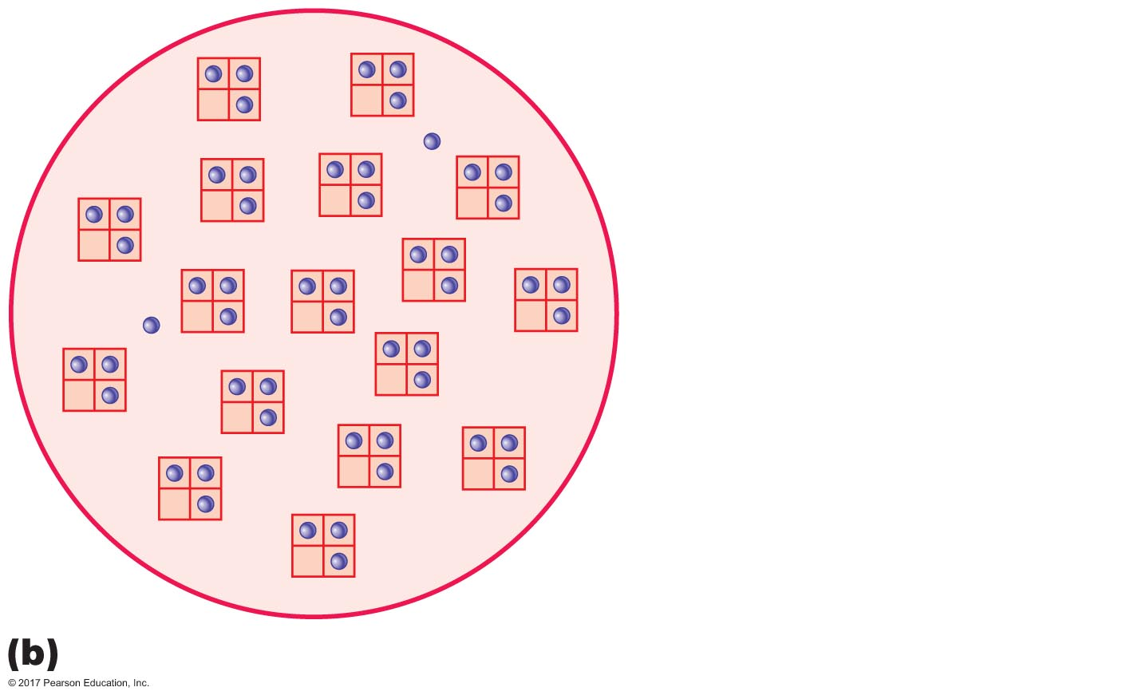
Figure 17.7b Saturation of hemoglobin.
Mixed venous blood
P_{O2} = 40 mm Hg
Hemoglobin = 75% saturated

Slide 50
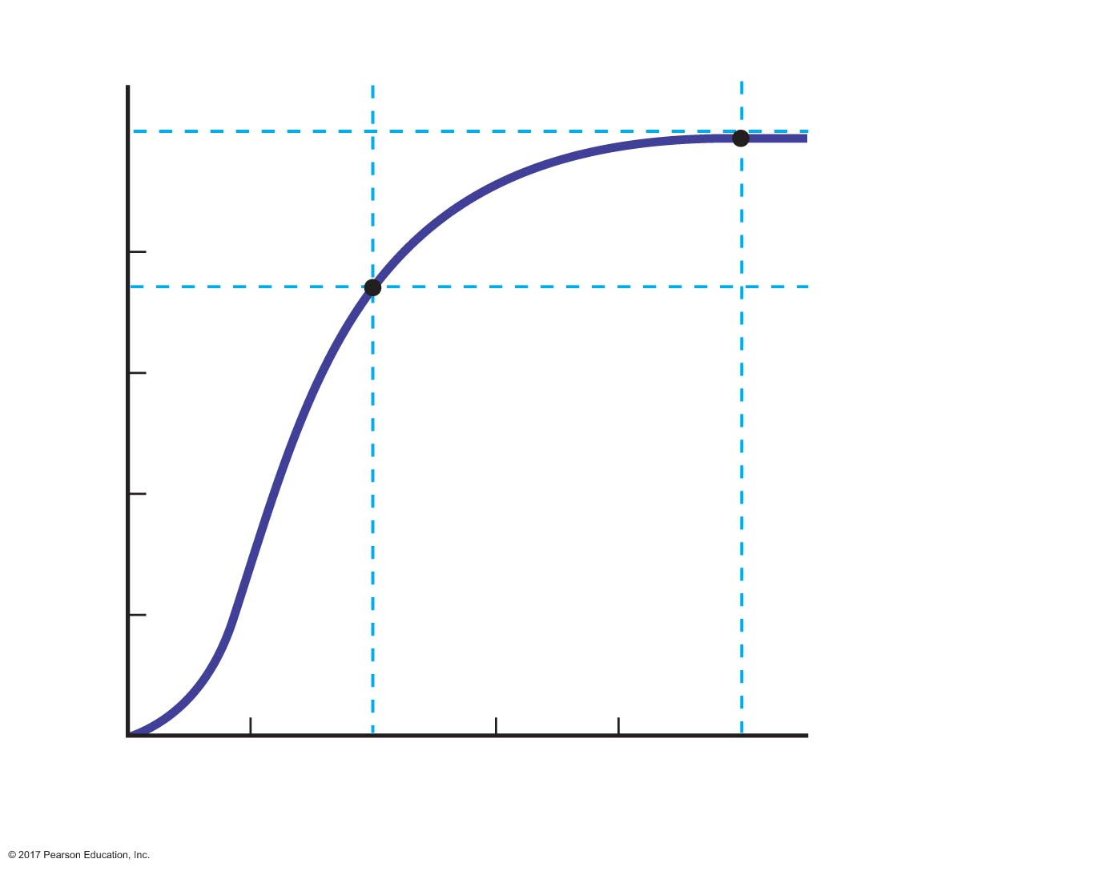
Figure 17.8 Hemoglobin-oxygen dissociation curve.
Systemic
veins
Systemic
arteries
100
Percent of O₂
unloaded by
hemoglobin
to tissues
80
60
Percent oxygen saturation of hemoglobin
40
20
0
20
40
60
80
100
P_{O2} (mm Hg)

Slide 51
Oxygen Transport in the Blood
Effects of O₂ affinity changes on Hb•O₂ dissociation curve
Shift right
Less loading of O₂ and less unloading
Shift left
More loading of O₂ and less unloading

Slide 52
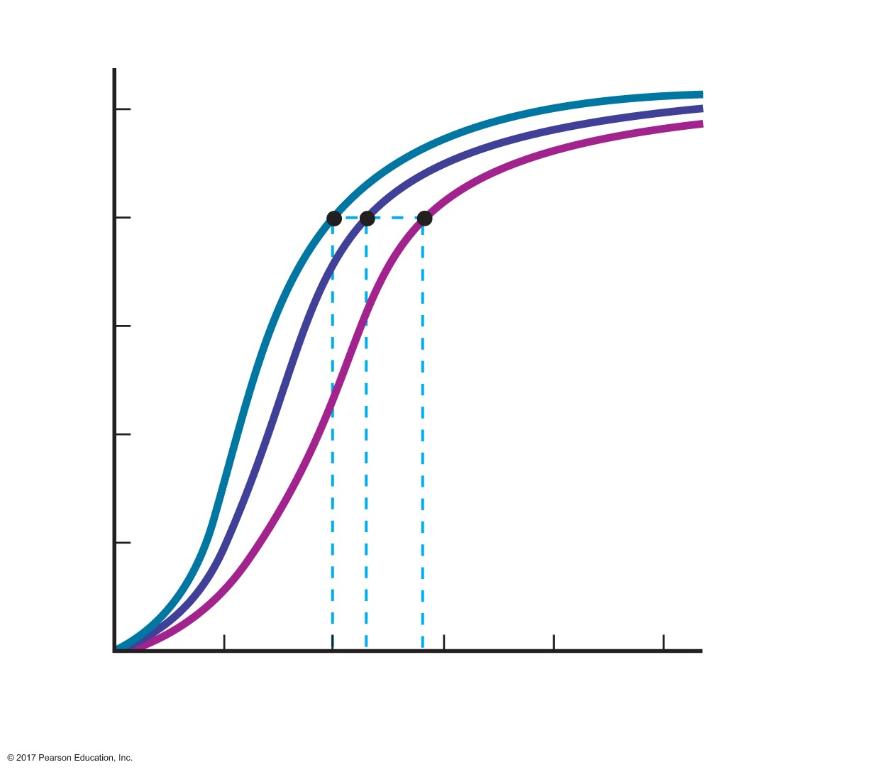
Figure 17.9 Effects of changes in the affinity of hemoglobin for oxygen on the hemoglobin-oxygen dissociation curve.
Leftward shift
(increased afﬁnity)
Normal
100
Rightward shift
(decreased afﬁnity)
80
60
Percent oxygen saturation of hemoglobin
40
20
0
20
40
60
80
100
P_{O2} (mm Hg)

Slide 53
Oxygen Transport in the Blood
Effects of temperature on Hb•O₂ dissociation curve
Higher temperature
Active tissues
Shift right
More O₂ unloading in tissues
More O₂ delivery to tissues

Slide 54
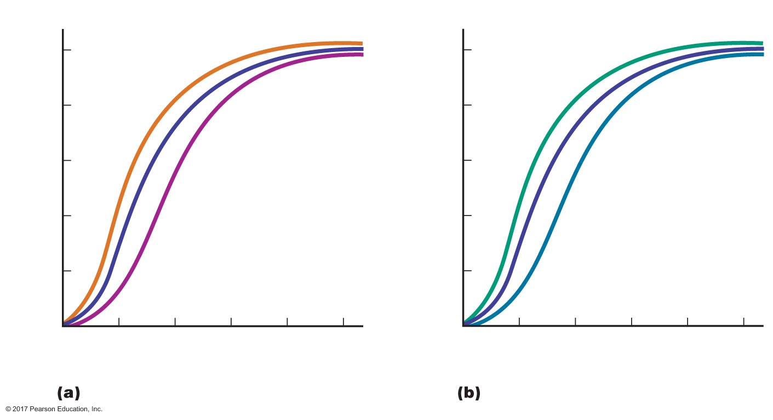
Figure 17.10 Effects of temperature and pH on the hemoglobin-oxygen dissociation curve.
20ºC
(increased afﬁnity)
pH = 7.60
(increased afﬁnity)
100
100
80
80
60
37ºC
(body temperature)
60
pH = 7.40
Percent oxygen saturation of hemoglobin
Percent oxygen saturation of hemoglobin
40
43ºC
(decreased afﬁnity)
40
pH = 7.20
(decreased afﬁnity)
20
20
0
20
40
60
80
100
0
20
40
60
80
100
P_{O2} (mm Hg)
P_{O2} (mm Hg)
Effects of temperature
Effects of pH

Slide 55
Oxygen Transport in the Blood
Effects of pH on Hb•O₂ dissociation curve
Bohr effect
Lower pH increases O₂ unloading
Active tissues
Produce more acid; pH decreases in tissues
Decreased pH causes shift right in saturation curve
More O₂ is unloaded to tissues

Slide 56
Oxygen Transport in the Blood
Effects of CO₂–carbamino effect
CO₂ reacts with hemoglobin to form carbaminohemoglobin
Hb + CO₂ HbCO₂
HbCO₂ has lower affinity for oxygen than Hb
Increased metabolic activity → increases CO₂
Increased oxygen unloading in active tissue

Slide 57
Oxygen Transport in the Blood
Effect of 2,3-DPG
2,3-DPG = 2,3-diphosphoglycerate
Produced in red blood cells under conditions of low O₂ such as anemia and high altitude
Synthesis inhibited by oxyhemoglobin
2,3-DPG decreases affinity of hemoglobin for O₂, enhancing O₂ unloading
Effect of carbon monoxide
Hemoglobin has greater affinity for carbon monoxide (CO) than for O₂
Prevents O₂ from binding to hemoglobin

Slide 58
Carbon Dioxide Transport in Blood
Role of carbonic anyhdrase in carbon dioxide transport
Carbon dioxide exchange and transport in systemic capillaries and veins
Carbon dioxide exchange and transport in pulmonary capillaries and veins
Effect of oxygen on carbon dioxide transport

Slide 59
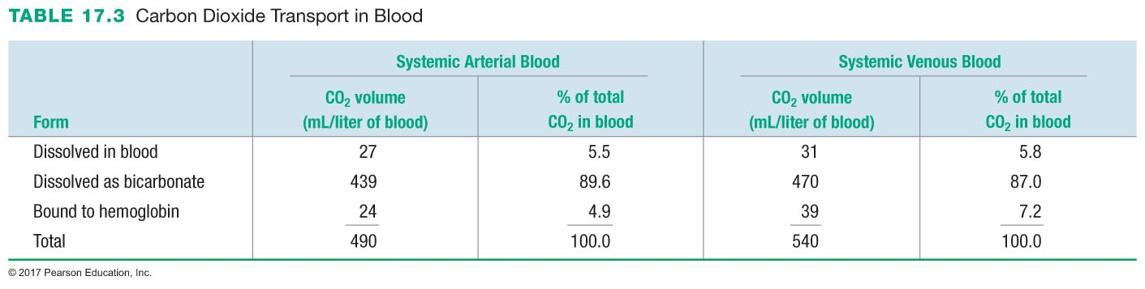

Slide 60
Carbon Dioxide Transport in Blood
CO₂ is more soluble in plasma than O₂, but still not very soluble
5–6% transported dissolved in plasma
CO₂ can bind to hemoglobin to form carbaminohemoglobin
5–8% transported bound to hemoglobin
CO₂ can be converted to bicarbonate by erythrocytes, then transported in plasma
86–90% of transported CO₂ dissolved in the plasma as bicarbonate

Slide 61
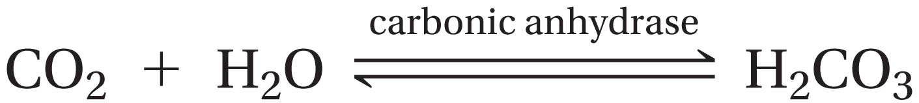
Carbon Dioxide Transport in Blood
Carbonic anhydrase
Enzyme that converts carbon dioxide and water to carbonic acid
Law of mass action: an increase in CO₂ causes an increase in bicarbonate and hydrogen ions

Slide 62
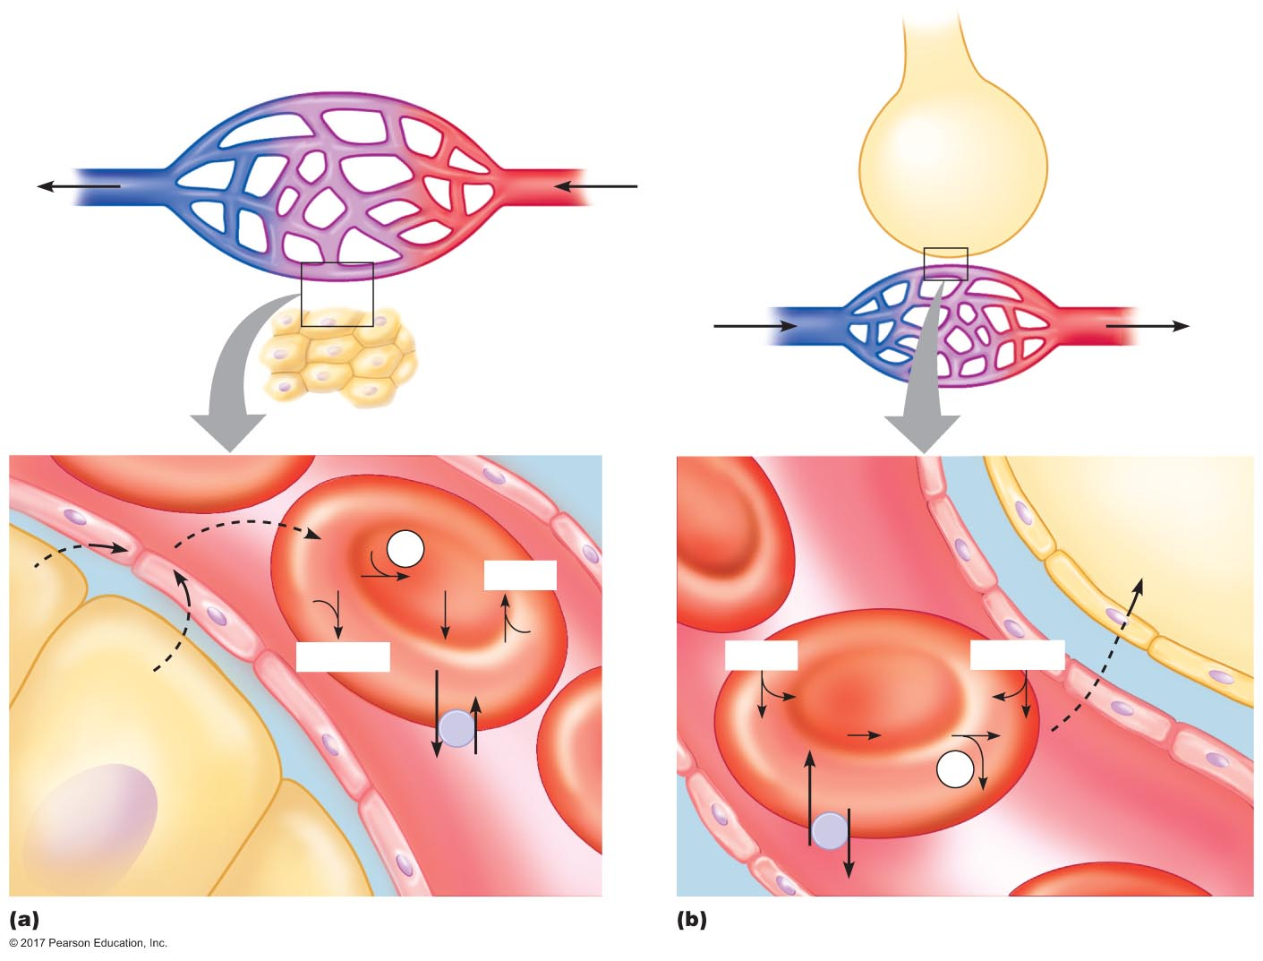
Figure 17.11 Carbon dioxide exchange and transport in blood.
Systemic capillaries
Blood ﬂow
P_{CO2} = 40 mm Hg
P_{CO2} = 46 mm Hg
P_{CO2} = 40 mm Hg
P_{CO2} = 46 mm Hg
P_{CO2} = 40 mm Hg
P_{CO2} = 46 mm Hg
Blood ﬂow
Pulmonary
capillaries
Erythrocytes
Plasma
Alveolar air
H₂O
CA
CO₂
CO₂
H₂CO₃
Hb • H
CO₂
CO₂
Hb
Hb
Hb • CO₂
HCO₃⁻ + H⁺
Hb • H
Hb • CO₂
CO₂
Hb
Hb
H⁺ + HCO₃⁻
H₂CO₃
CO₂
CI⁻
CA
Capillary wall
CI⁻
H₂O
Tissue cells
Interstitial ﬂuid
Erythrocytes
Plasma
HCO₃⁻

Slide 63
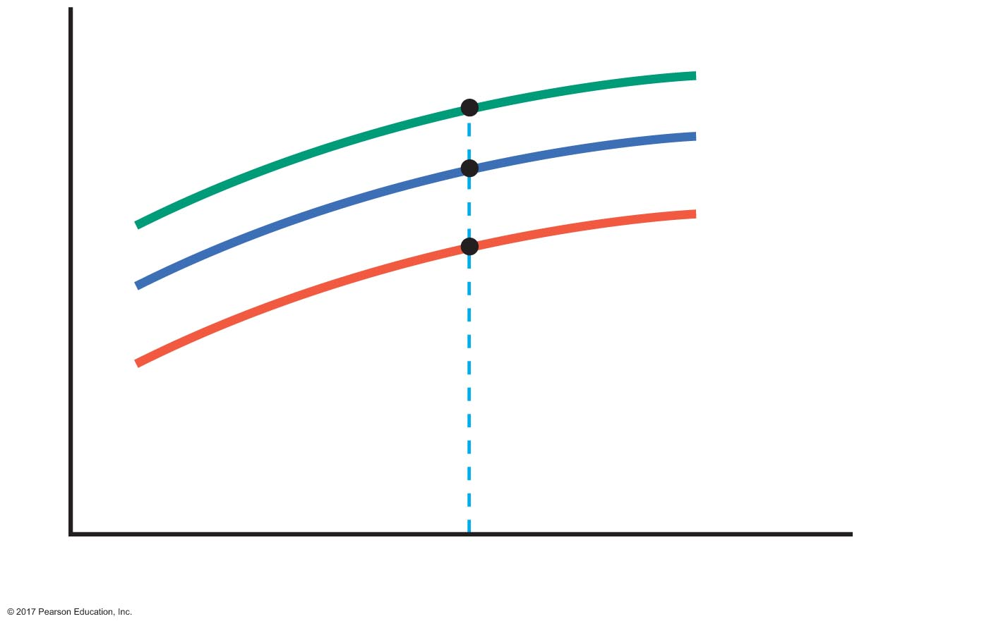
Figure 17.12 Effect of P_{O2} on carbon dioxide transport.
P_{O2} = 0 mm Hg
P_{O2} = 40 mm Hg
P_{O2} = 100 mm Hg
Total blood CO₂
P_{CO2} (mm Hg)

Slide 64
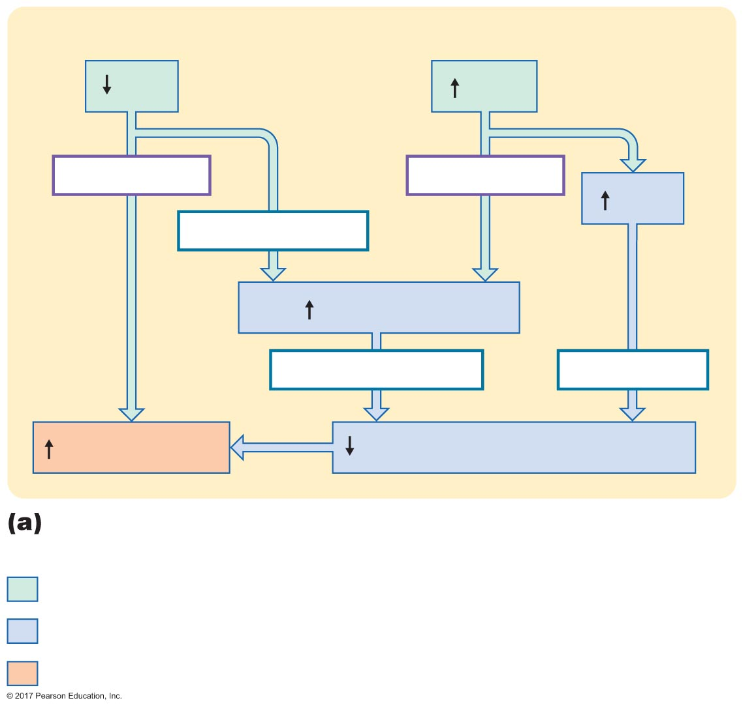
Figure 17.13a Effects of P_{O2} and P_{CO2} on carbon dioxide and oxygen loading and unloading.
Blood
P_{O2}
P_{CO2}
Direct effect
Direct effect
[H⁺]
Haldane effect
CO₂ loading
Carbamino effect
Bohr effect
O₂ unloading
Hemoglobin's afﬁnity for O₂
CO₂ loading and O₂ unloading of hemoglobin in respiring
tissue
Initial stimulus
Physiological response
Result

Slide 65
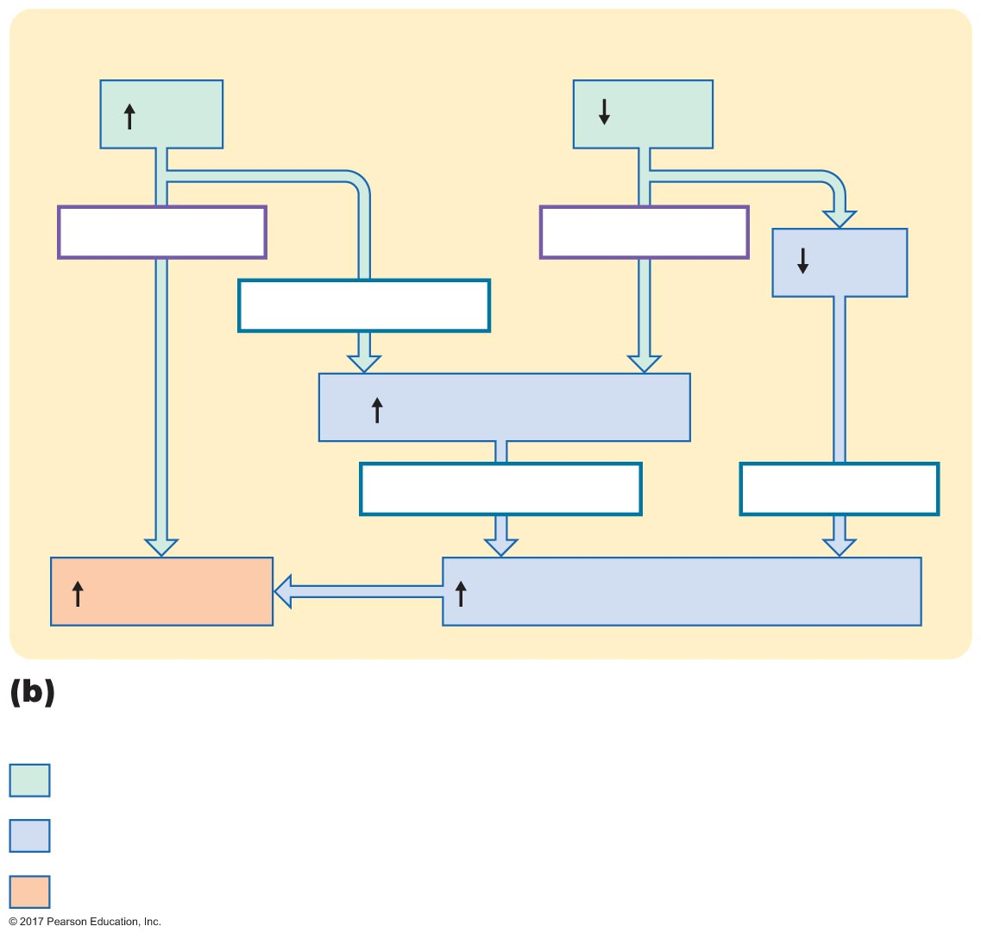
Figure 17.13b Effects of P_{O2} and P_{CO2} on carbon dioxide and oxygen loading and unloading.
Blood
P_{O2}
P_{CO2}
Direct effect
Direct effect
[H⁺]
Haldane effect
CO₂ unloading
Carbamino effect
Bohr effect
O₂ loading
Hemoglobin's afﬁnity for O₂
CO₂ unloading and O₂ loading of hemoglobin in lungs
Initial stimulus
Physiological response
Result

Slide 66
17.5 Central Regulation of Ventilation
Neural control of breathing by motor neurons
Generation of breathing rhythm in the brainstem
Peripheral input to respiratory centers

Slide 67
Neural Control of Breathing by Motor Neurons
Respiratory muscles = skeletal muscles
Controlled by motor neurons
Inspiration
Phrenic nerve → diaphragm
External intercostal nerve → external intercostal muscles
Expiration
Internal intercostal nerve → internal intercostal muscles

Slide 68
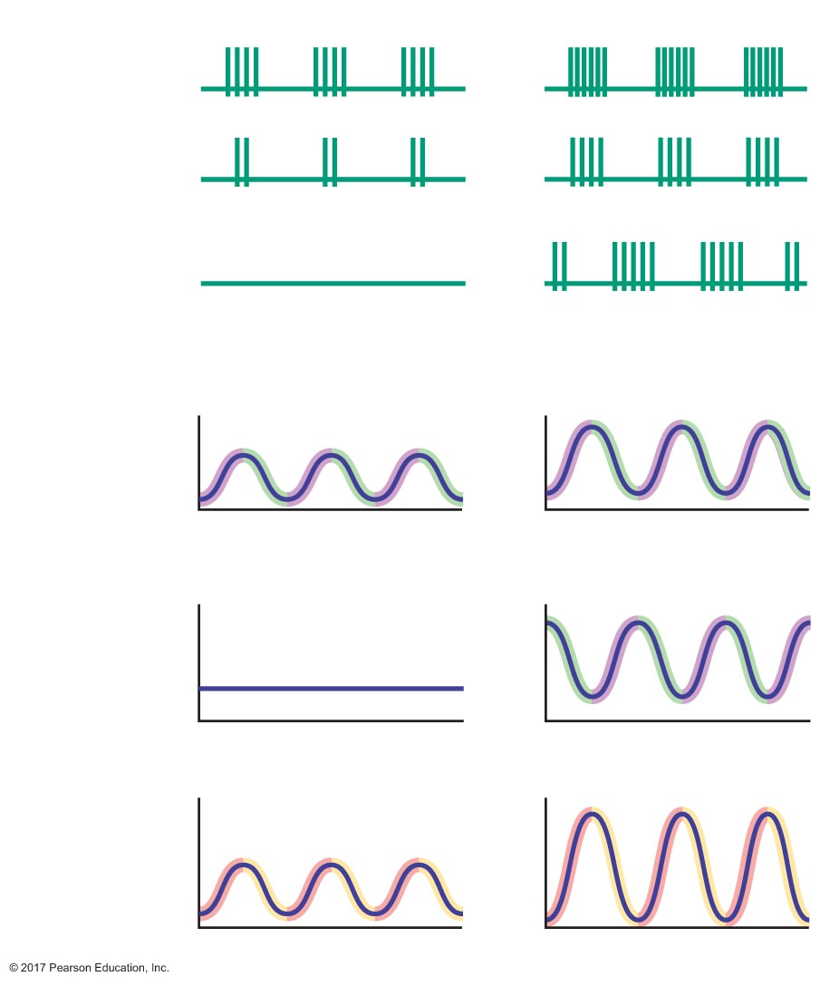
Figure 17.14 A comparison of quiet breathing and active ventilation.
Quiet breathing
Active ventilation
Phrenic
nerve
–70 mV
External
Intercostal
nerve
–70 mV
Internal
Intercostal
nerve
–70 mV
Contraction
Relaxation
Inspiratory muscle
tension
0
0
Relaxation
Contraction
Expiratory muscle
tension
0
0
Inspiration
Expiration
Lung volume
Time
Time

Slide 69
Neural Control of Breathing by Motor Neurons
Components that generate the breathing rhythm
Phrenic nerve
Internal and external intercostal nerves
Inspiratory and expiratory neurons
Respiratory control centers of medulla
Respiratory control centers of pons
Central pattern generator

Slide 70
Generation of the Breathing Rhythm in the Brainstem
Brainstem respiratory centers
Inspiratory neurons
Depolarize during inspiration
Expiratory neurons
Depolarize during expiration
Mixed neurons
Have properties of both inspiratory and expiratory neurons

Slide 71
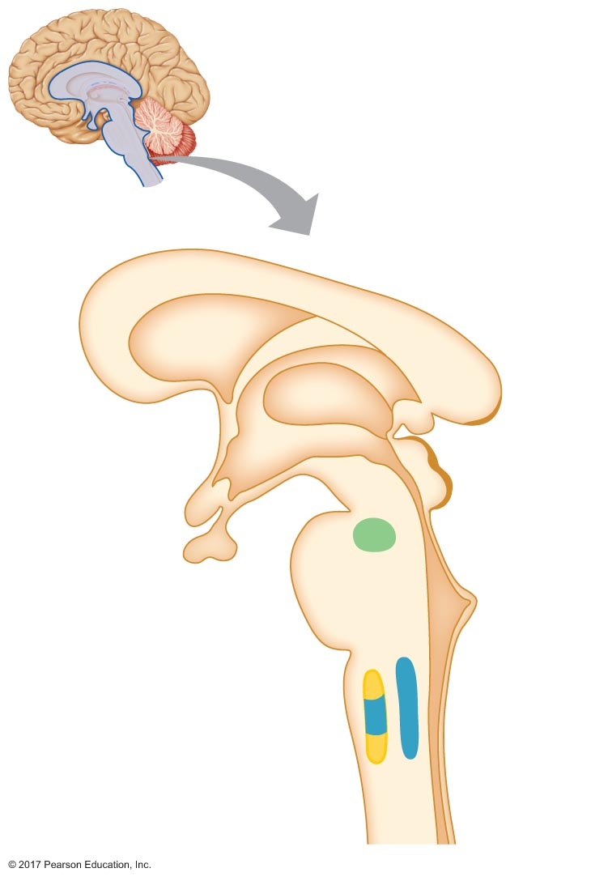
Figure 17.15 Brainstem centers of respiratory control.
Midbrain
Pontine respiratory
group (PRG)
Pons
Pons
Medulla oblongata
Ventral respiratory
group (VRG)
Medulla
Dorsal respiratory
group (DRG)
Spinal
cord

Slide 72
Generation of the Breathing Rhythm in the Brainstem
In medulla
Two respiratory control centers located on each side of the medulla
Ventral respiratory group (VRG): nucleus ambiguus
Dorsal respiratory group (DRG): nucleus tractus solitarius
Inspiratory neurons are hypothesized to control motor neurons to inspiratory muscles
Expiratory neurons are hypothesized to control motor neurons to expiratory muscles and/or inhibit inspiratory neurons

Slide 73
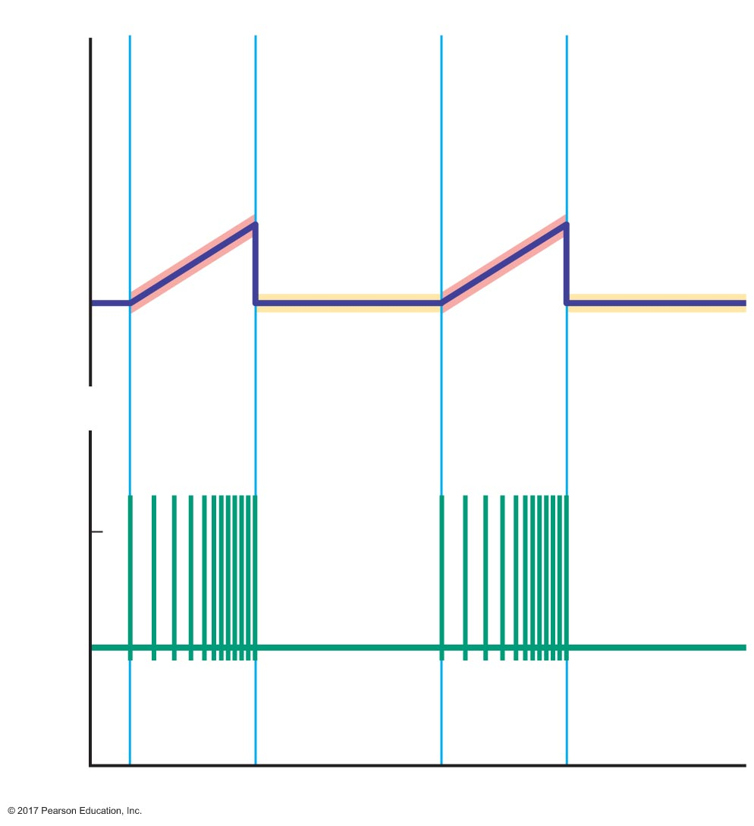
Figure 17.16 Activity of inspiratory neurons.
Inspiration
Expiration
Inspiration
Expiration
Frequency of action potentials (Hz)
0
0
Membrane potential (mV)
–70
Time

Slide 74
Generation of the Breathing Rhythm in the Brainstem
Pontine respiratory group
Contains inspiratory, expiratory, and mixed neurons
May regulate transitions between inspiration and expiration

Slide 75
Generation of the Breathing Rhythm in the Brainstem
Central pattern generator
Central pattern generator establishes respiratory cycle
Location and mechanism of action are unknown

Slide 76
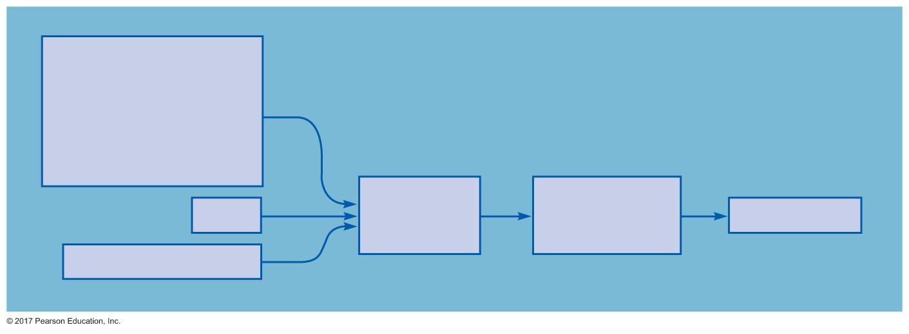
Figure 17.17 Model of respiratory control during quiet breathing.
Sensory input:
Central chemoreceptors
Peripheral chemoreceptors
Pulmonary stretch receptors
Irritant receptors
Proprioceptors
Pons
Central pattern
generator
(medulla)
Inspiratory neurons
of DRG and VRG
(medulla)
Breathing rhythm
Cortex (voluntary control)

Slide 77
Peripheral Input to Respiratory Centers
Chemoreceptors
Pulmonary stretch receptors
Irritant receptors
Muscle and joint proprioceptors

Slide 78
17.6 Control of Ventilation by Chemoreceptors
Chemoreceptors
Detect blood levels of O₂ and CO₂
Two types
Peripheral chemoreceptors in carotid bodies
Central chemoreceptors in medulla oblongata

Slide 79
Chemoreceptors
Peripheral chemoreceptors
Located in carotid bodies near carotid sinus
Direct contact with arterial blood
Communicate with afferent neurons via chemical messenger
Afferent neurons project to medullary respiratory control areas
Respond mainly to changes in blood pH

Slide 80
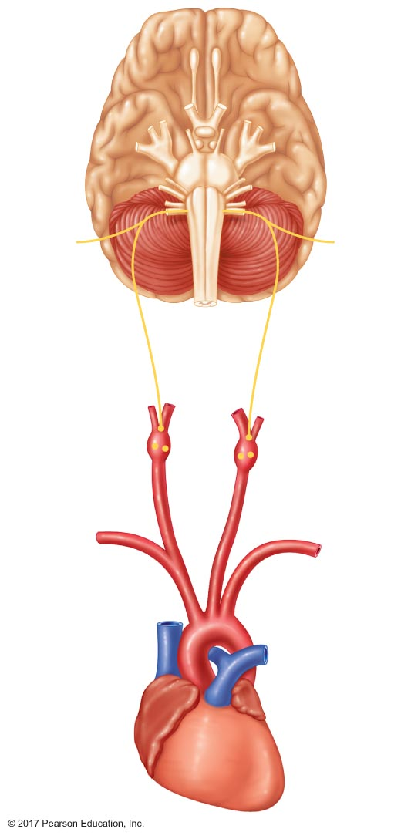
Figure 17.18 Location of peripheral chemoreceptors in the carotid bodies.
Pons
Medulla
Chemoreceptor
afferents (part of
glossopharyngeal
nerve)
Carotid bifurcation
Carotid body
Carotid sinus
Baroreceptors
in wall of
carotid sinus
Common carotid
artery
Aortic arch
Aorta
Heart

Slide 81
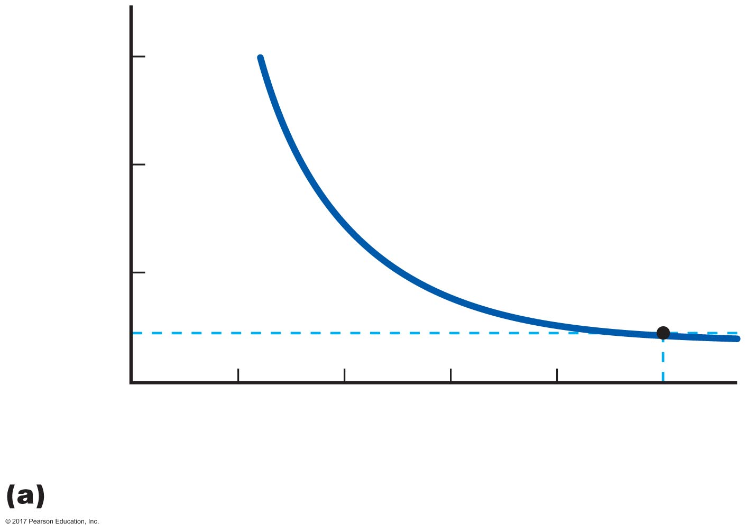
Figure 17.19a Respiratory control by chemoreceptors.
30
20
Normal
resting
level
Minute ventilation
(L/min)
10
0
20
40
60
80
100
Arterial P_{O2} (mm Hg)
Effects of arterial P_{O2} on ventilation

Slide 82
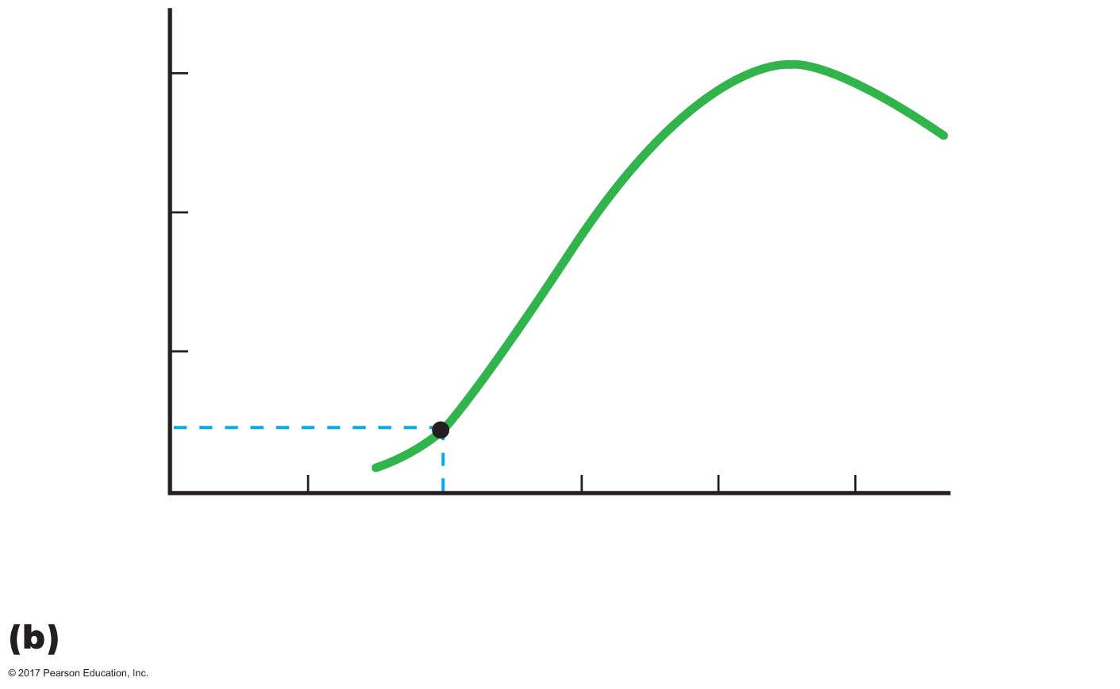
Figure 17.19b Respiratory control by chemoreceptors.
30
At P_{CO2} > 90 mm Hg: coma
20
Normal
resting
level
Minute ventilation
(L/min)
At P_{CO2} > 180 mm Hg: death
10
0
20
40
60
80
100
Arterial P_{CO2} (mm Hg)
Effects of arterial P_{CO2} on ventilation

Slide 83
Chemoreceptors
Central chemoreceptors
Located on the ventral surface of medulla
Respond to changes in pH of the CSF
Not directly responsive to CO₂
Respond indirectly to CO₂ via pH
Increased CO₂ decreases pH
Not responsive to changes in [O₂]

Slide 84
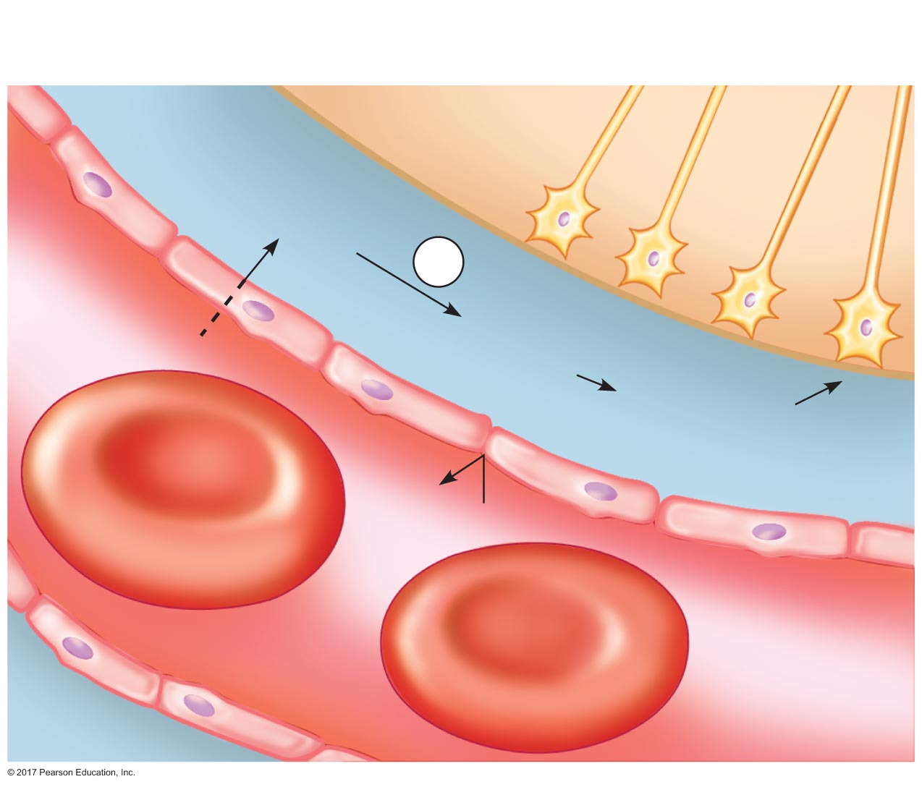
Figure 17.20 Activation of central chemoreceptors in the medulla oblongata.
Central
chemoreceptors
Cerebrospinal
ﬂuid
Medulla
oblongata
CO₂ + H₂O
CA
Capillary
in brain
CO₂
H₂CO₃
HCO₃– + H⁺
H⁺
Blood-brain
barrier
Erythrocytes
Capillary
endothelial cells
Plasma

Slide 85
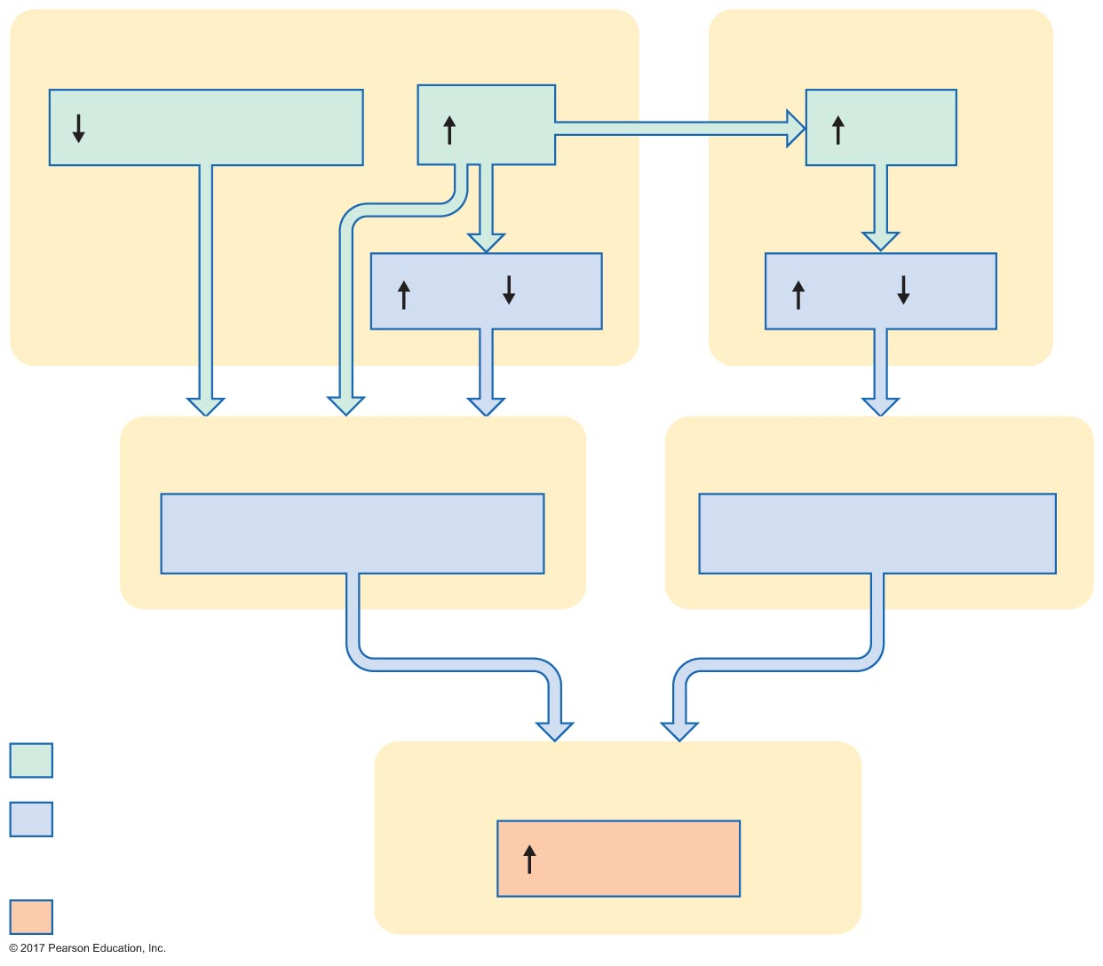
Figure 17.21 Chemoreceptor reflexes: The effects of changes in arterial P_{O2}, P_{CO2}, and pH on ventilation.
Arterial blood
Cerebrospinal ﬂuid
P_{O2} < 60 mm Hg
P_{CO2}
P_{CO2}
[H⁺]
( pH)
[H⁺]
( pH)
Peripheral chemoreceptors
Central chemoreceptors
Detect and respond
Detect and respond
Initial stimulus
Respiratory control centers
Physiological
response
Ventilation
Result

Slide 86
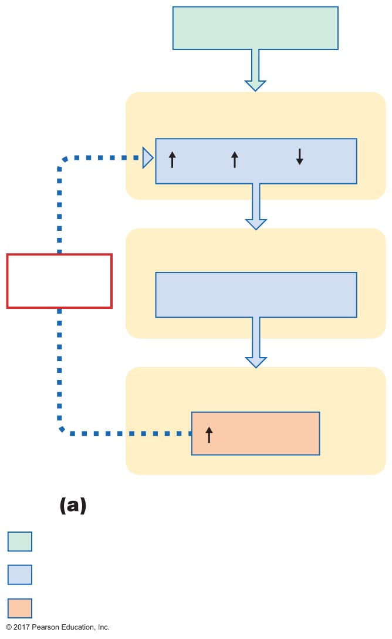
Figure 17.22a The effects of hypoventilation and hyperventilation on minute ventilation.
Hypoventilation
Arterial blood
P_{CO2},
[H⁺],
( P_{O2})
Chemoreceptors
Negative
feedback
Detect and respond
Respiratory control center
Ventilation
Hypoventilation
Initial stimulus
Physiological response
Result

Slide 87
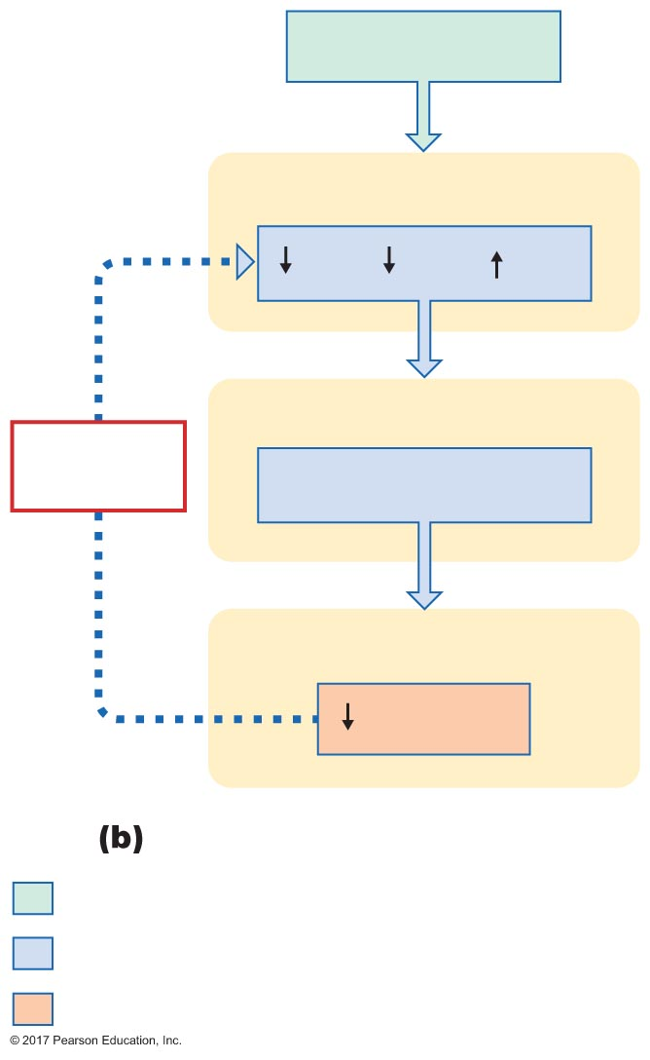
Figure 17.22b The effects of hypoventilation and hyperventilation on minute ventilation.
Hypoventilation
Arterial blood
P_{CO2},
[H⁺],
( P_{O2})
Chemoreceptors
Negative
feedback
Detect and respond
Respiratory control center
Ventilation
Hyperventilation
Initial stimulus
Physiological response
Result

Slide 88
17.7 Local Regulation of Ventilation and Perfusion
Ventilation-perfusion ratios
Local control of ventilation and perfusion

Slide 89
Ventilation-Perfusion Ratios
Matching of ventilation to perfusion
Ventilation (V) = rate of air flow
Perfusion (Q) = rate of blood flow
Local ventilation and perfusion are regulated to match
VA/Q = ventilation-perfusion ratio

Slide 90
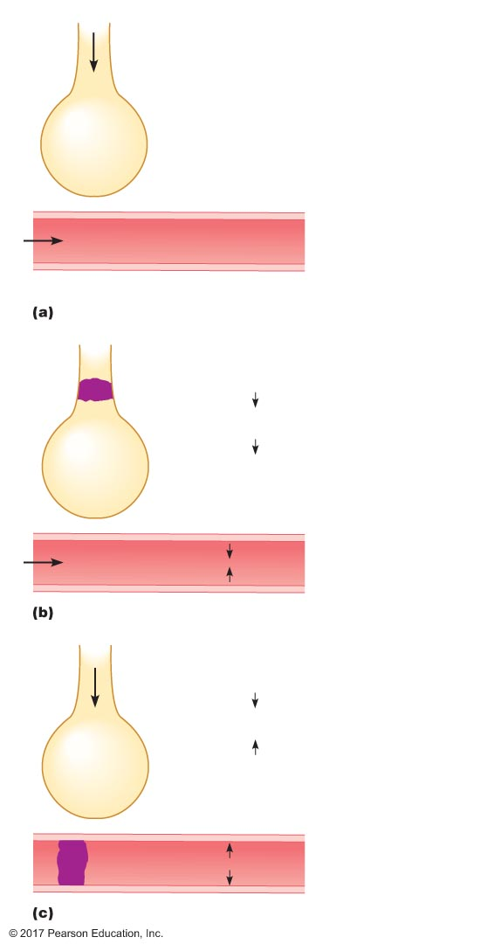
Figure 17.23 Ventilation-perfusion ratios.
•
V_{A}
•
V_{A}
= 1
•
Alveolus
Q
•
P_{O2} = 100 mm Hg
Q
P_{CO2} = 40 mm Hg
Pulmonary capillary
Normal
•
V_{A}
Obstruction
of airway
•
•
V_{A}
, no change in Q
•
V_{A}
•
Q
•
P_{O2}
Q
P_{CO2}
Decreased ventilation
•
V_{A}
•
•
Q
, no change in V_{A}
•
V_{A}
•
Q
Obstruction
of blood vessel
P_{O2}
•
•
V_{A} = rate of ventilation
Q
P_{CO2}
•
Q = rate of perfusion
Decreased perfusion

Slide 91
Ventilation-Perfusion Ratios
If ventilation to certain alveoli decreases
Increased P_{CO2} and decreased P_{O2} in blood and air
Increased P_{CO2} in bronchioles → bronchodilation
Decreased P_{O2} in P. arterioles → vasoconstriction
If perfusion to certain alveoli decreases
Increased P_{O2} and decreased P_{CO2} in blood and air
Increased P_{O2} in P. arterioles → vasodilation
Decreased P_{CO2} in bronchioles → bronchoconstriction

Slide 92
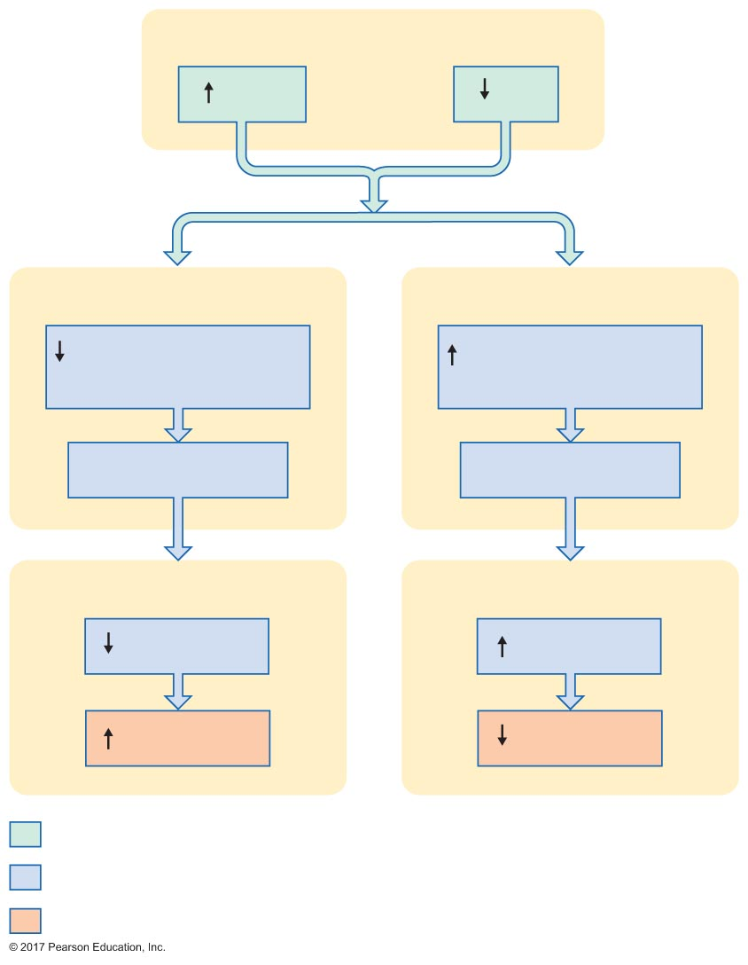
Figure 17.24 Local controls of ventilation and perfusion.
Slide 1
Alveoli and pulmonary interstitial ﬂuid
P_{CO2}
P_{O2}
Bronchioles
Pulmonary arterioles
Contractile activity
of smooth muscle
Contractile activity
of smooth muscle
Bronchodilation
Vasoconstriction
Respiratory tract
Pulmonary circuit
Resistance
Resistance
Ventilation
Perfusion
Initial stimulus
Physiological response
Result

Slide 93

Figure 17.24 Local controls of ventilation and perfusion.
Slide 2
Alveoli and pulmonary interstitial ﬂuid
P_{CO2}
P_{O2}
Initial stimulus
Physiological response
Result

Slide 94
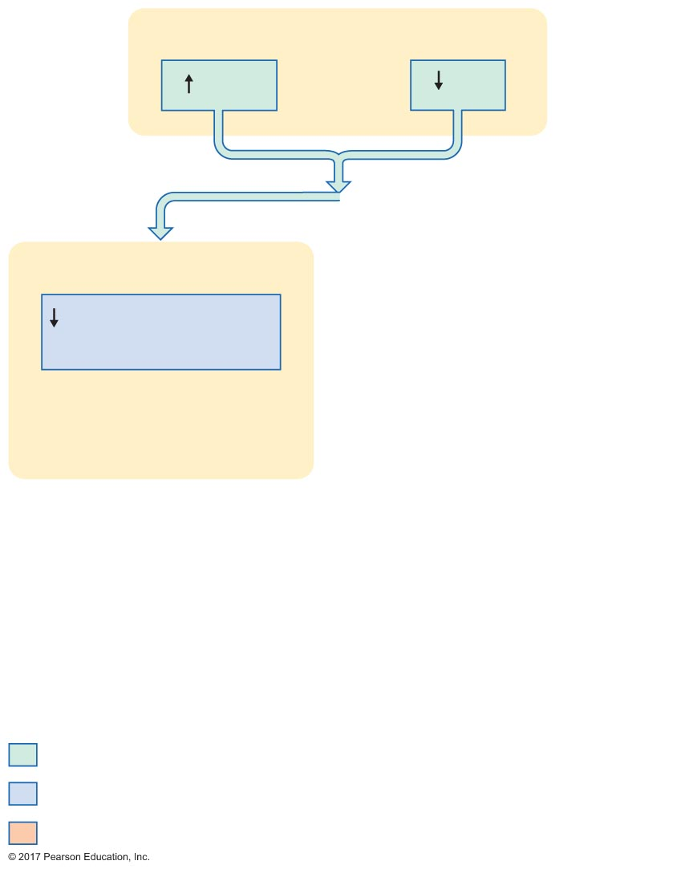
Figure 17.24 Local controls of ventilation and perfusion.
Slide 3
Alveoli and pulmonary interstitial ﬂuid
P_{CO2}
P_{O2}
Bronchioles
Contractile activity
of smooth muscle
Initial stimulus
Physiological response
Result

Slide 95
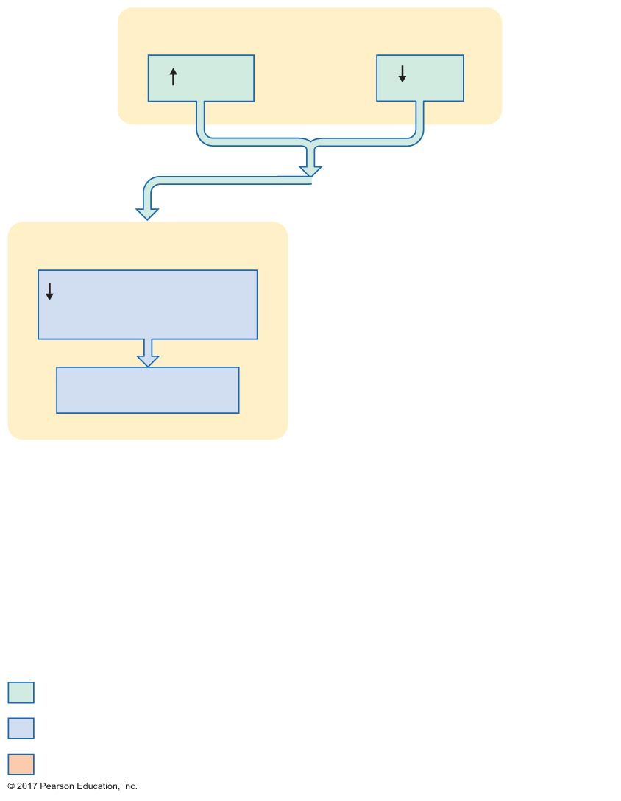
Figure 17.24 Local controls of ventilation and perfusion.
Slide 4
Alveoli and pulmonary interstitial ﬂuid
P_{CO2}
P_{O2}
Bronchioles
Contractile activity
of smooth muscle
Bronchodilation
Initial stimulus
Physiological response
Result

Slide 96
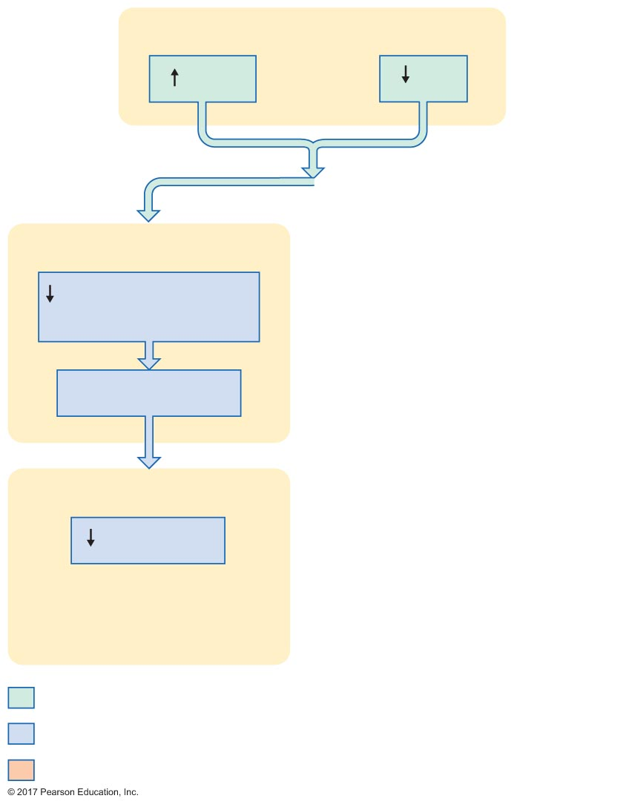
Figure 17.24 Local controls of ventilation and perfusion.
Slide 5
Alveoli and pulmonary interstitial ﬂuid
P_{CO2}
P_{O2}
Bronchioles
Contractile activity
of smooth muscle
Bronchodilation
Respiratory tract
Resistance
Initial stimulus
Physiological response
Result

Slide 97
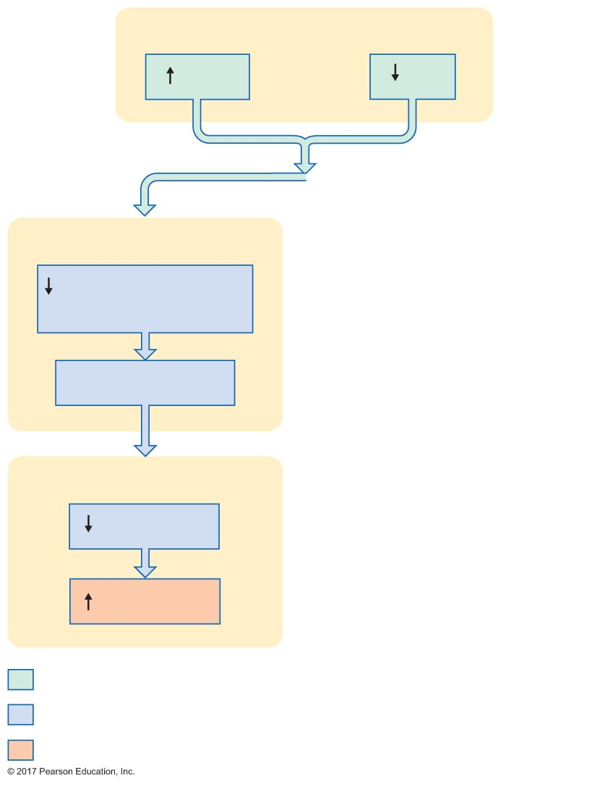
Figure 17.24 Local controls of ventilation and perfusion.
Slide 6
Alveoli and pulmonary interstitial ﬂuid
P_{CO2}
P_{O2}
Bronchioles
Contractile activity
of smooth muscle
Bronchodilation
Respiratory tract
Resistance
Ventilation
Initial stimulus
Physiological response
Result

Slide 98
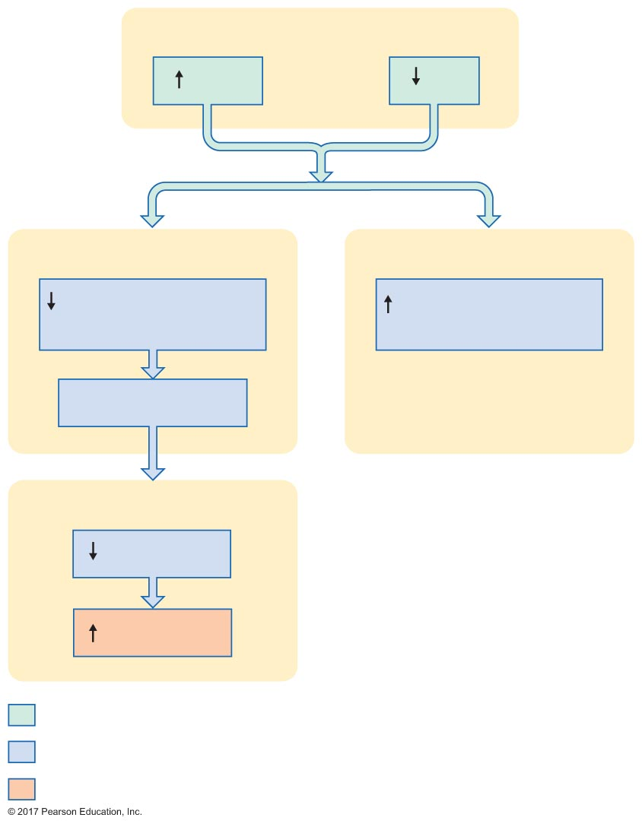
Figure 17.24 Local controls of ventilation and perfusion.
Slide 7
Alveoli and pulmonary interstitial ﬂuid
P_{CO2}
P_{O2}
Bronchioles
Pulmonary arterioles
Contractile activity
of smooth muscle
Contractile activity
of smooth muscle
Bronchodilation
Respiratory tract
Resistance
Ventilation
Initial stimulus
Physiological response
Result

Slide 99
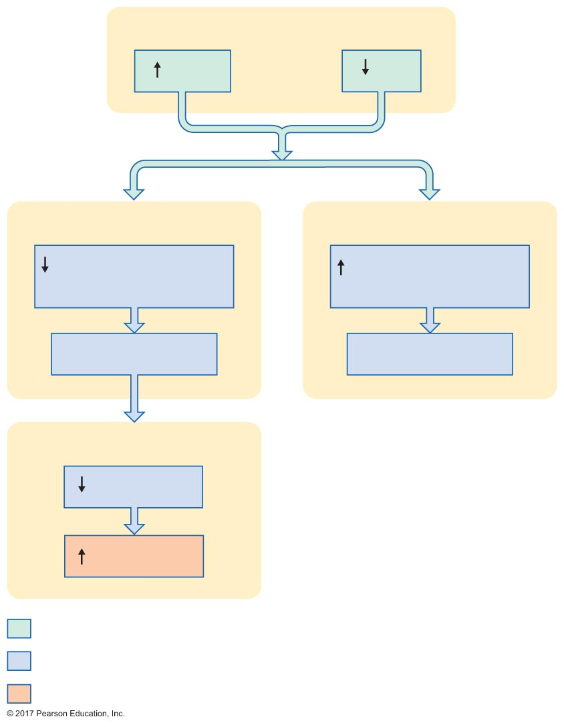
Figure 17.24 Local controls of ventilation and perfusion.
Slide 8
Alveoli and pulmonary interstitial ﬂuid
P_{CO2}
P_{O2}
Bronchioles
Pulmonary arterioles
Contractile activity
of smooth muscle
Contractile activity
of smooth muscle
Bronchodilation
Vasoconstriction
Respiratory tract
Resistance
Ventilation
Initial stimulus
Physiological response
Result

Slide 100
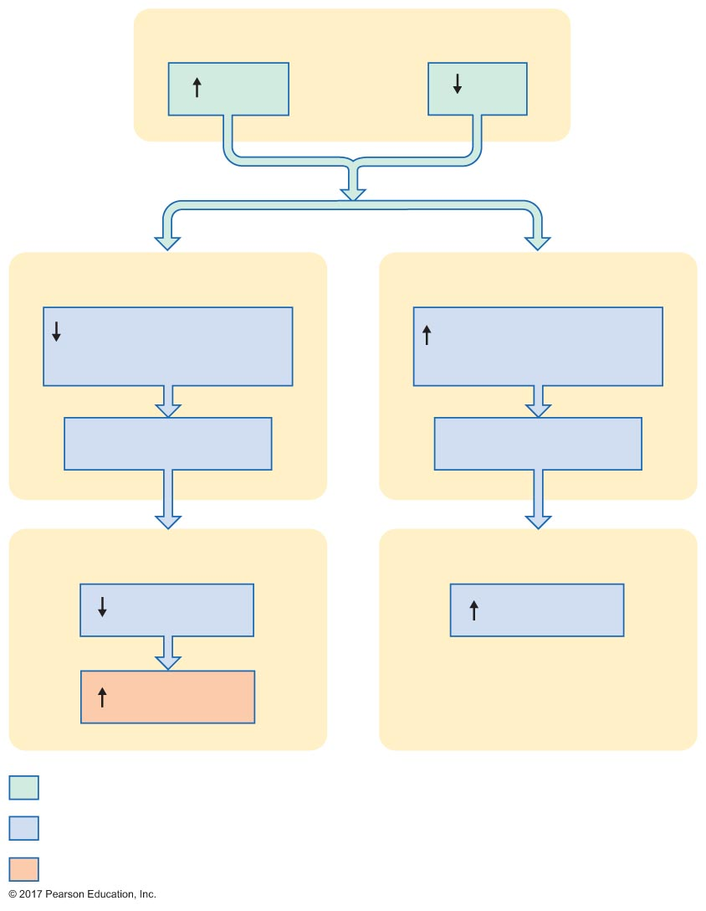
Figure 17.24 Local controls of ventilation and perfusion.
Slide 9
Alveoli and pulmonary interstitial ﬂuid
P_{CO2}
P_{O2}
Bronchioles
Pulmonary arterioles
Contractile activity
of smooth muscle
Contractile activity
of smooth muscle
Bronchodilation
Vasoconstriction
Respiratory tract
Pulmonary circuit
Resistance
Resistance
Ventilation
Initial stimulus
Physiological response
Result

Slide 101
Figure 17.24 Local controls of ventilation and perfusion.
Slide 10
Alveoli and pulmonary interstitial ﬂuid
P_{CO2}
P_{O2}
Bronchioles
Pulmonary arterioles
Contractile activity
of smooth muscle
Contractile activity
of smooth muscle
Bronchodilation
Vasoconstriction
Respiratory tract
Pulmonary circuit
Resistance
Resistance
Ventilation
Perfusion
Initial stimulus
Physiological response
Result

Slide 102
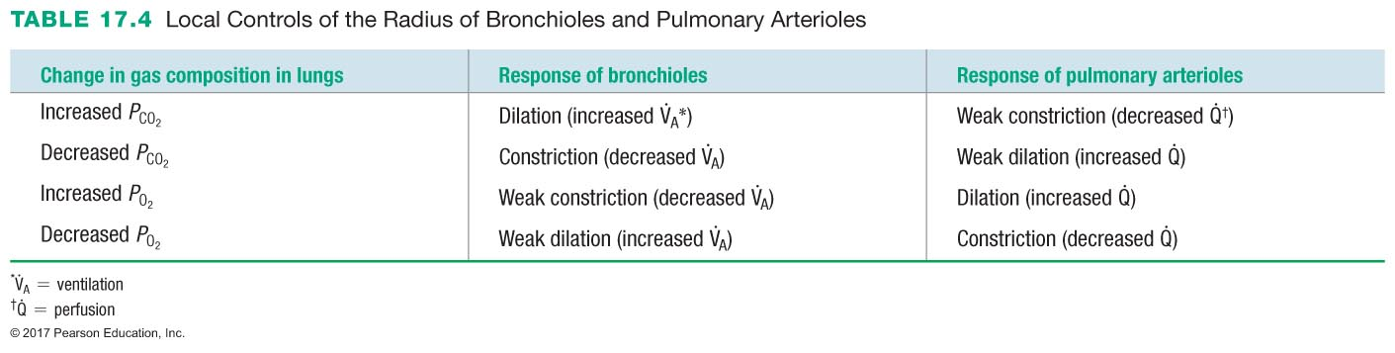

Slide 103
17.8 The Respiratory System in Acid-Base Homeostasis
Acid-base disturbances in blood
The role of the respiratory system in acid-base balance

Slide 104
Acid-Base Disturbances in Blood
Normal blood pH = 7.4 (range 7.3–7.42)
Respiratory and renal systems regulate blood pH
Small changes in pH have large physiological effects
Alter protein activity
Acidosis: blood pH < 7.35
CNS depression
Alkalosis: blood pH > 7.45
CNS over-excitation

Slide 105
The Role of the Respiratory System in Acid-Base Balance
Hemoglobin functions as a buffer
Deoxyhemoglobin has greater affinity for H⁺
Hb + H⁺ HbH
Bicarbonate ions as a buffer
HCO₃– + H⁺ H₂CO₃ CO₂ + H₂O
Can regulate pH by regulating CO₂ levels

Slide 106
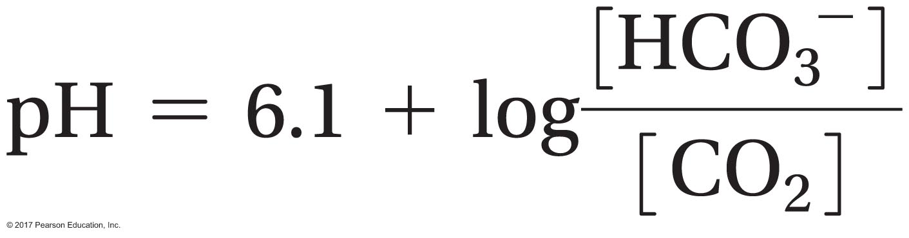
The Role of the Respiratory System in Acid-Base Balance
Henderson-Hasselbalch equation
To maintain normal arterial pH = 7.4,
[HCO₃–] : [CO₂] must be 20:1
Respiratory system regulates [CO₂]
Kidneys regulate [HCO₃–]

Slide 107
The Role of the Respiratory System in Acid-Base Balance
Respiratory acid-base disturbances
Respiratory acidosis
Caused by increased [CO₂]
Respiratory alkalosis
Caused by decreased [CO₂]

